Slide 1
Class Activities to Increase Student Engagement
Sheng-Chu Lu
Pingree School

Slide 2
Session Goal
To Explore different class activities to encourage students stay engaged.

Slide 3
Set up the norms with students first
Who is the judge?
Team work helps learning.
Be appreciative when partners do it correctly. Be Nice when partners mess up.
Cheer for spirit

Slide 4
Touch & Go
Suitable for vocabulary
Allow them some preparation time as a class and small groups
Variation: It could be done as pairs at their desk

Slide 5
Around the World
Suitable for vocabulary (speaking and writing)
Two people compete, but everyone participates
Once students say or show their answers, they can’t change
Encourage students to imagine where they are going
Let’s try: ”places” for speaking

Slide 6
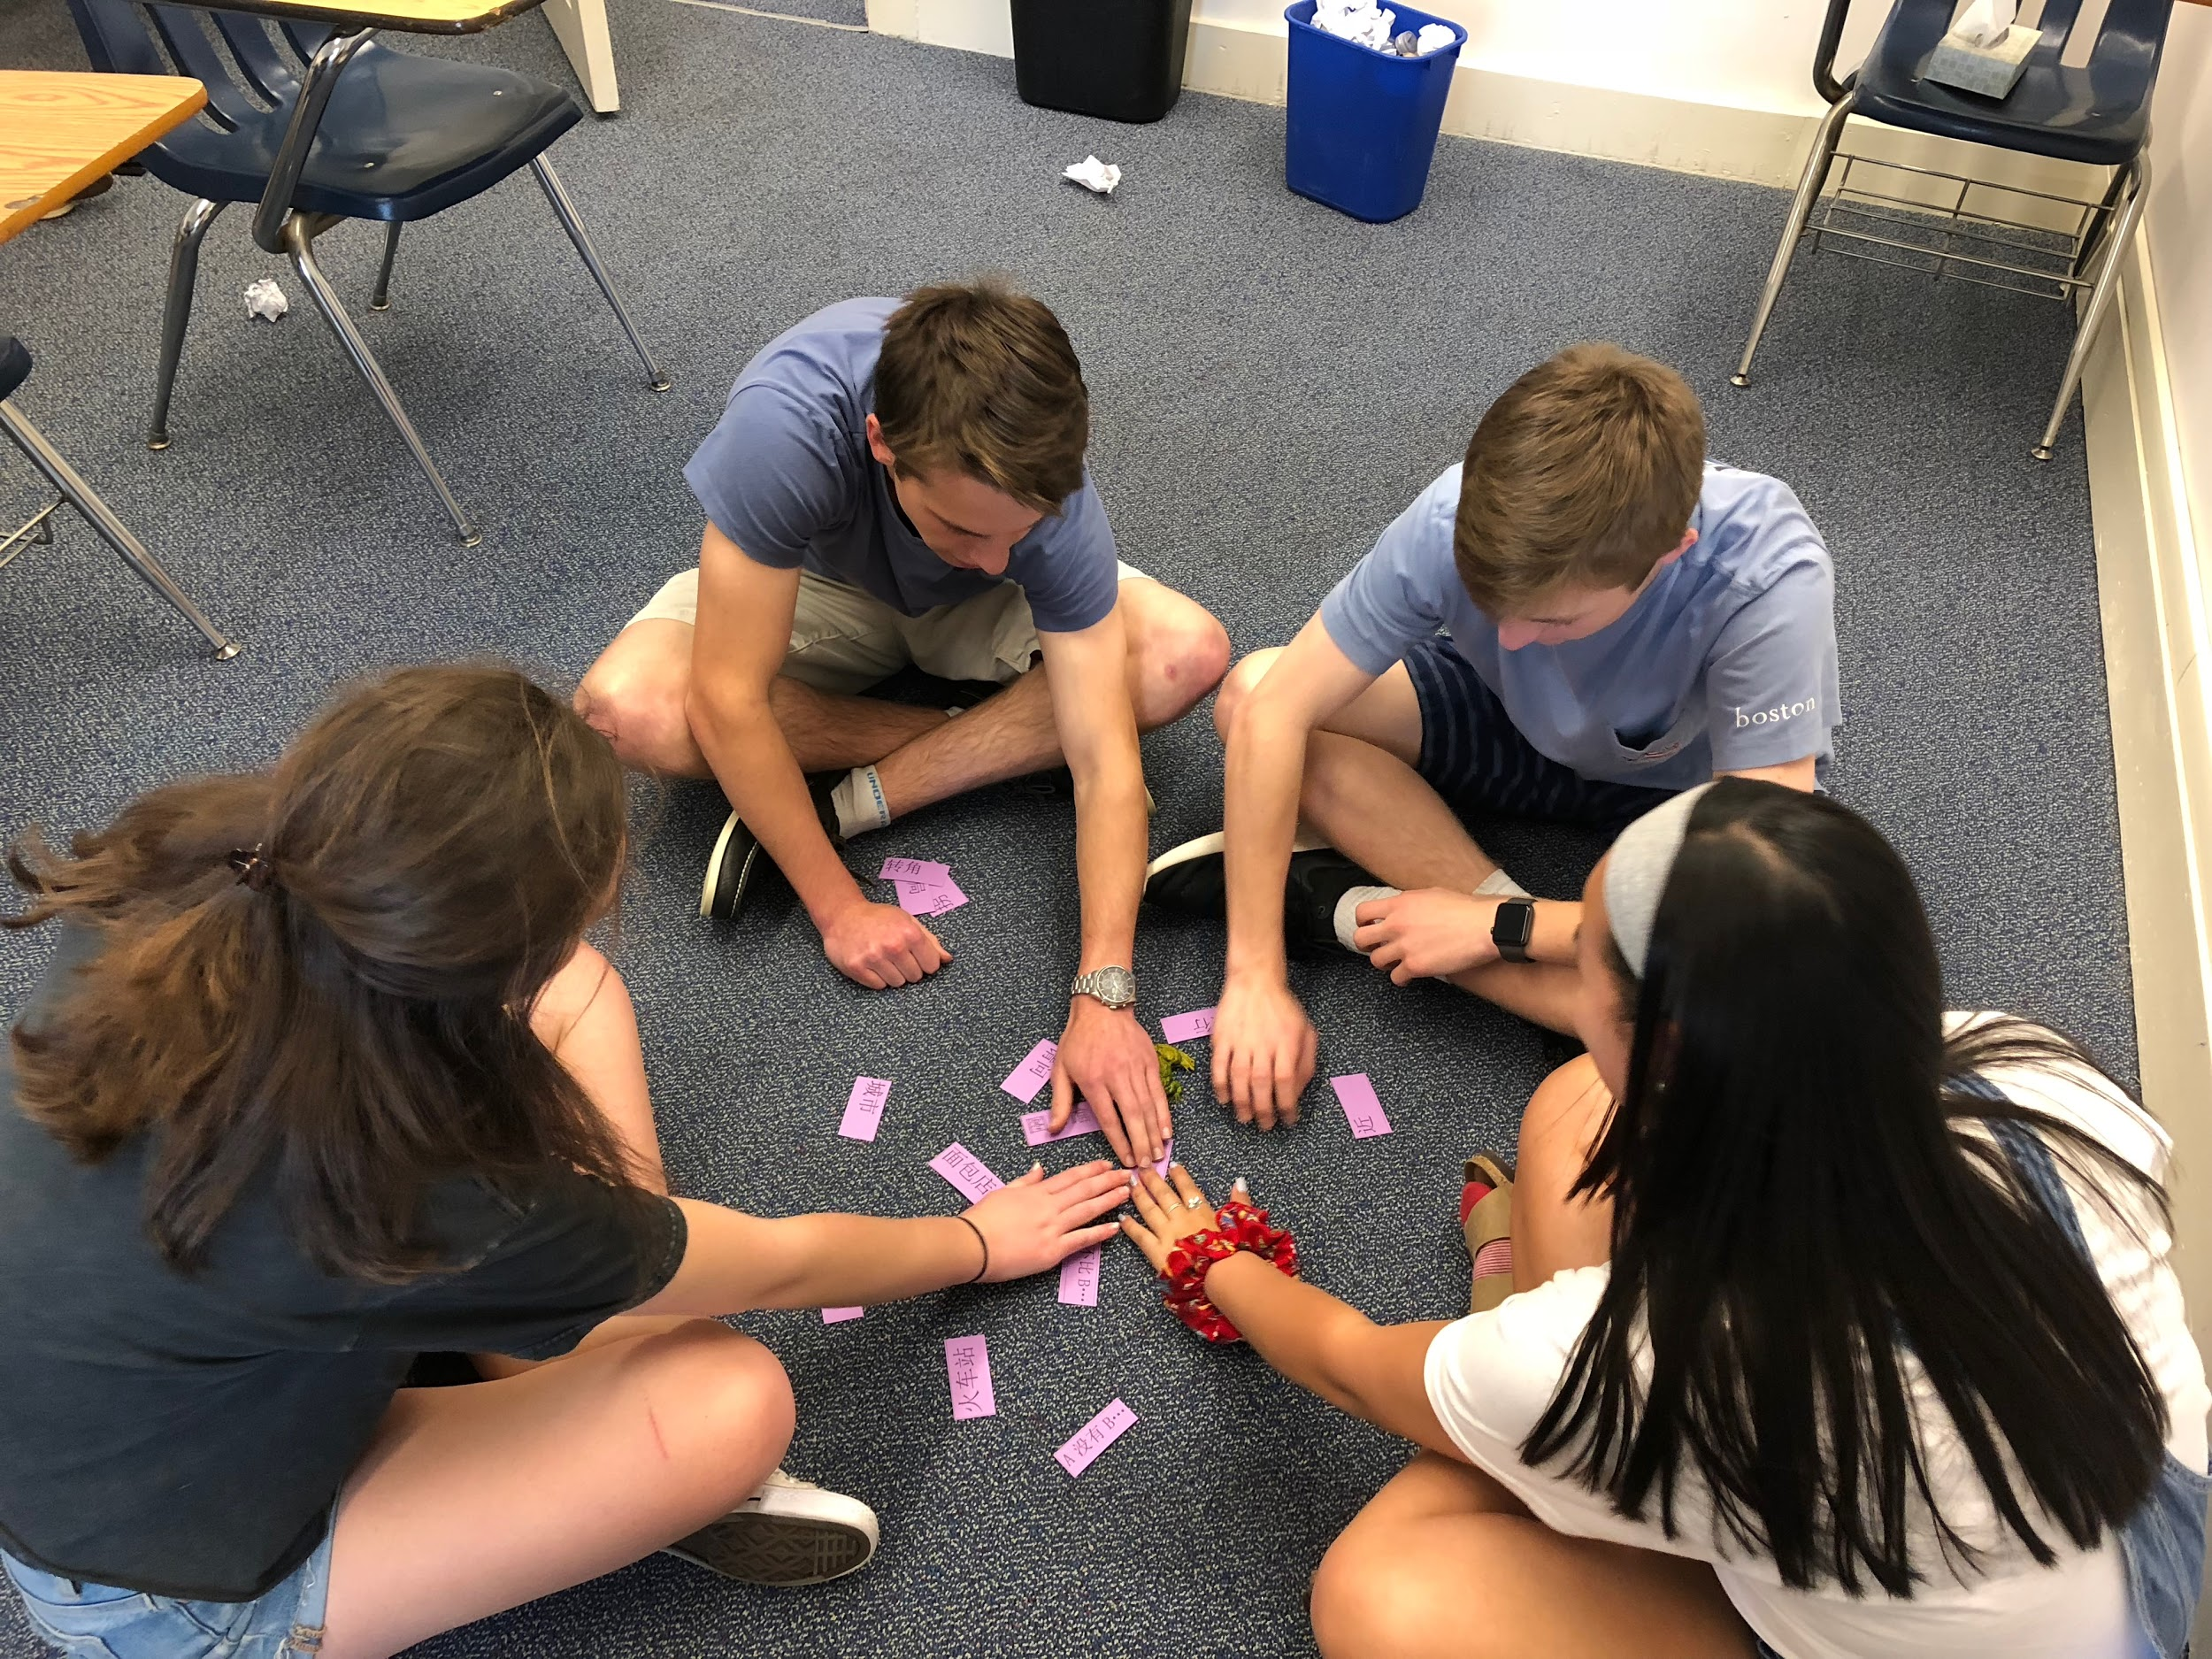
Slapjack
Suitable for vocabulary
Group of 3-5
Let’s try

Slide 7
Volleyball- Sentence Structures
Suitable for sentence structures
Allow a few minutes to have group discussion/let students learn how to say it correctly
Two teams and teacher points to students randomly to answer, so they stay focused
If they didn’t pay attention and ask for a repeat, it’s the other team’s turn to steal the point
Let’s try: see the next slide for examples

Slide 8
Volleyball- Let’s try the following sentences
To have two teams first:
After finishing doing homework, I will go to the park to relax.
Although I don’t review, I still get high scores.
Because weather is not good today, I don’t want to go out.

Slide 9
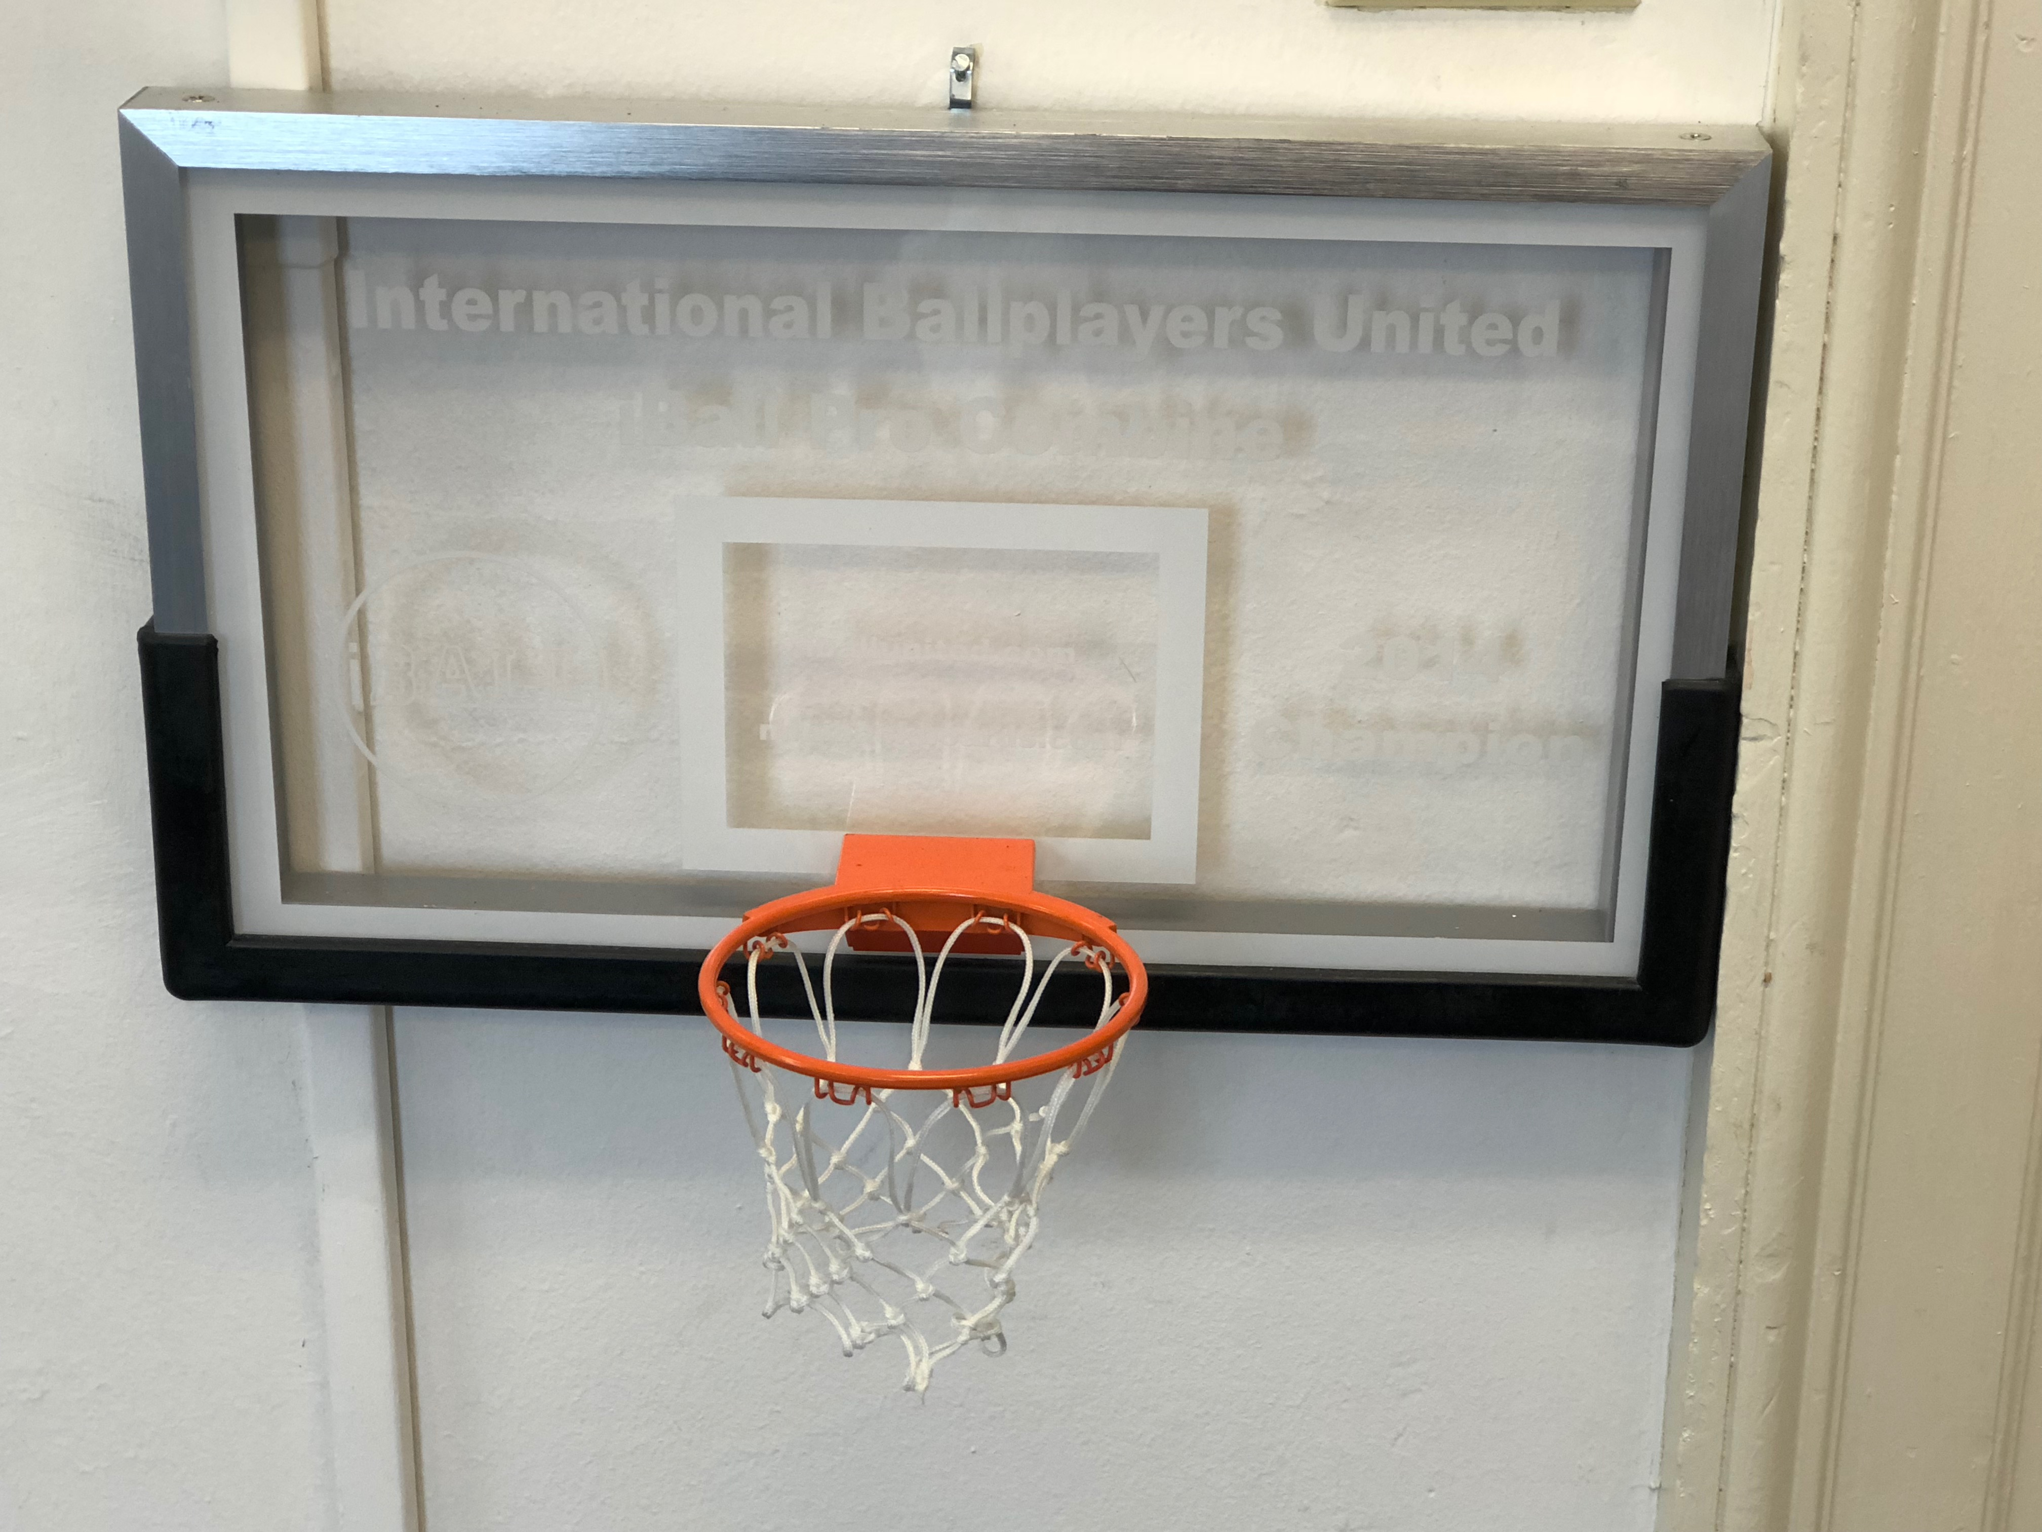
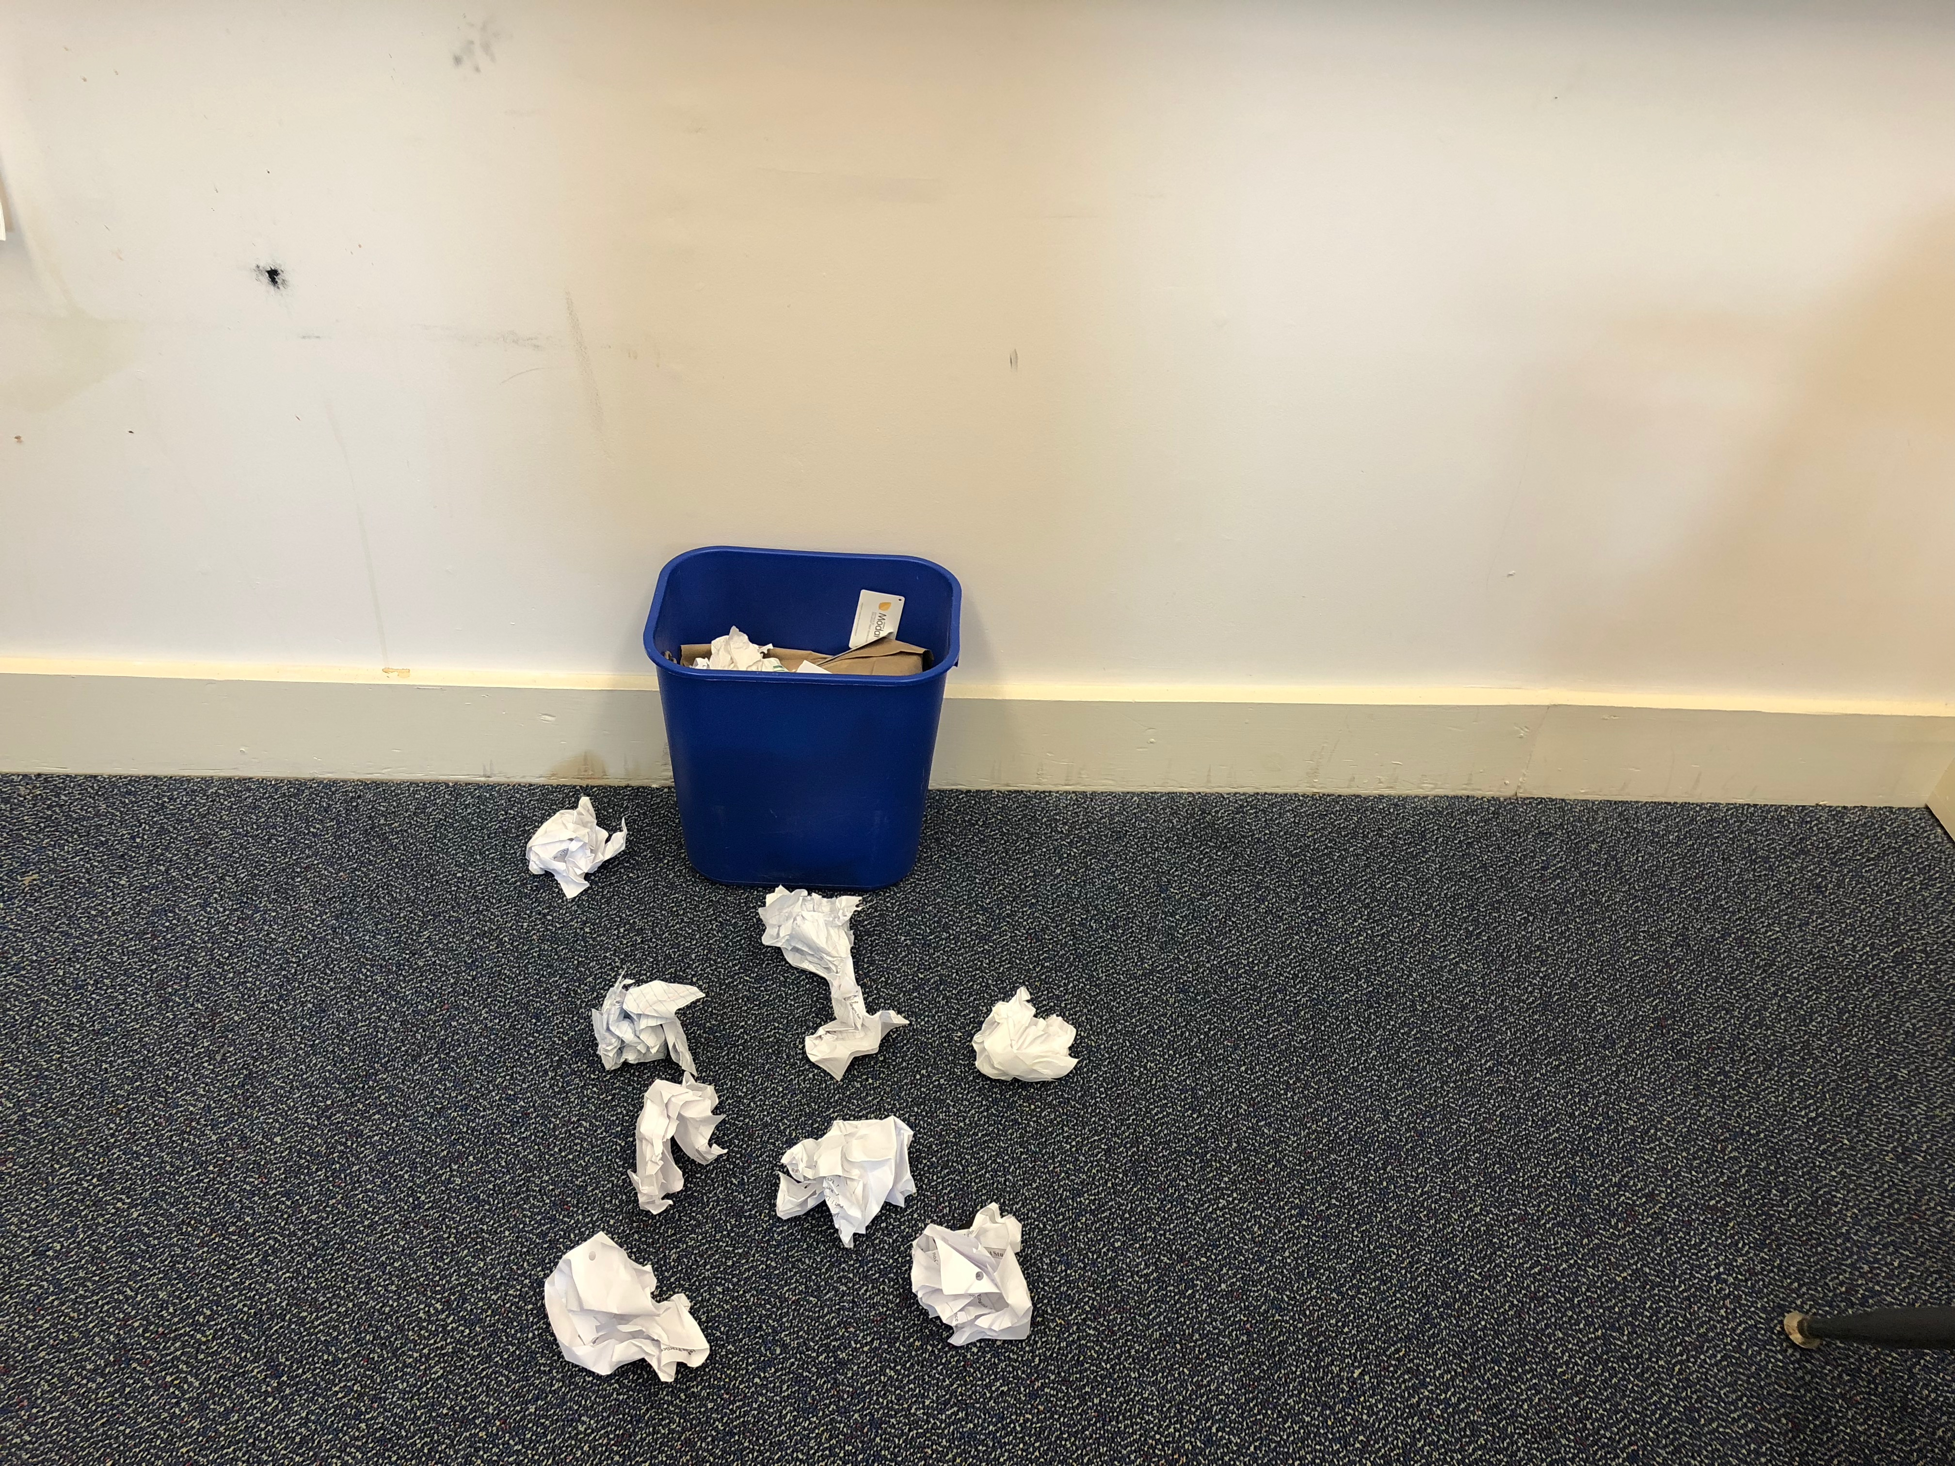
Basketball Writing Game
Two groups
Each group has the same amount of paper
Exchange what they wrote and examine which ones might not qualified to make a basketball
Go over as a class
Start shooting basketballs

Slide 10
Writing Art Project
Suitable for practicing writing vocabulary or sentence structures
Can be a class project or small group project
Write, get checked, ready to contribute for art project.

Slide 11
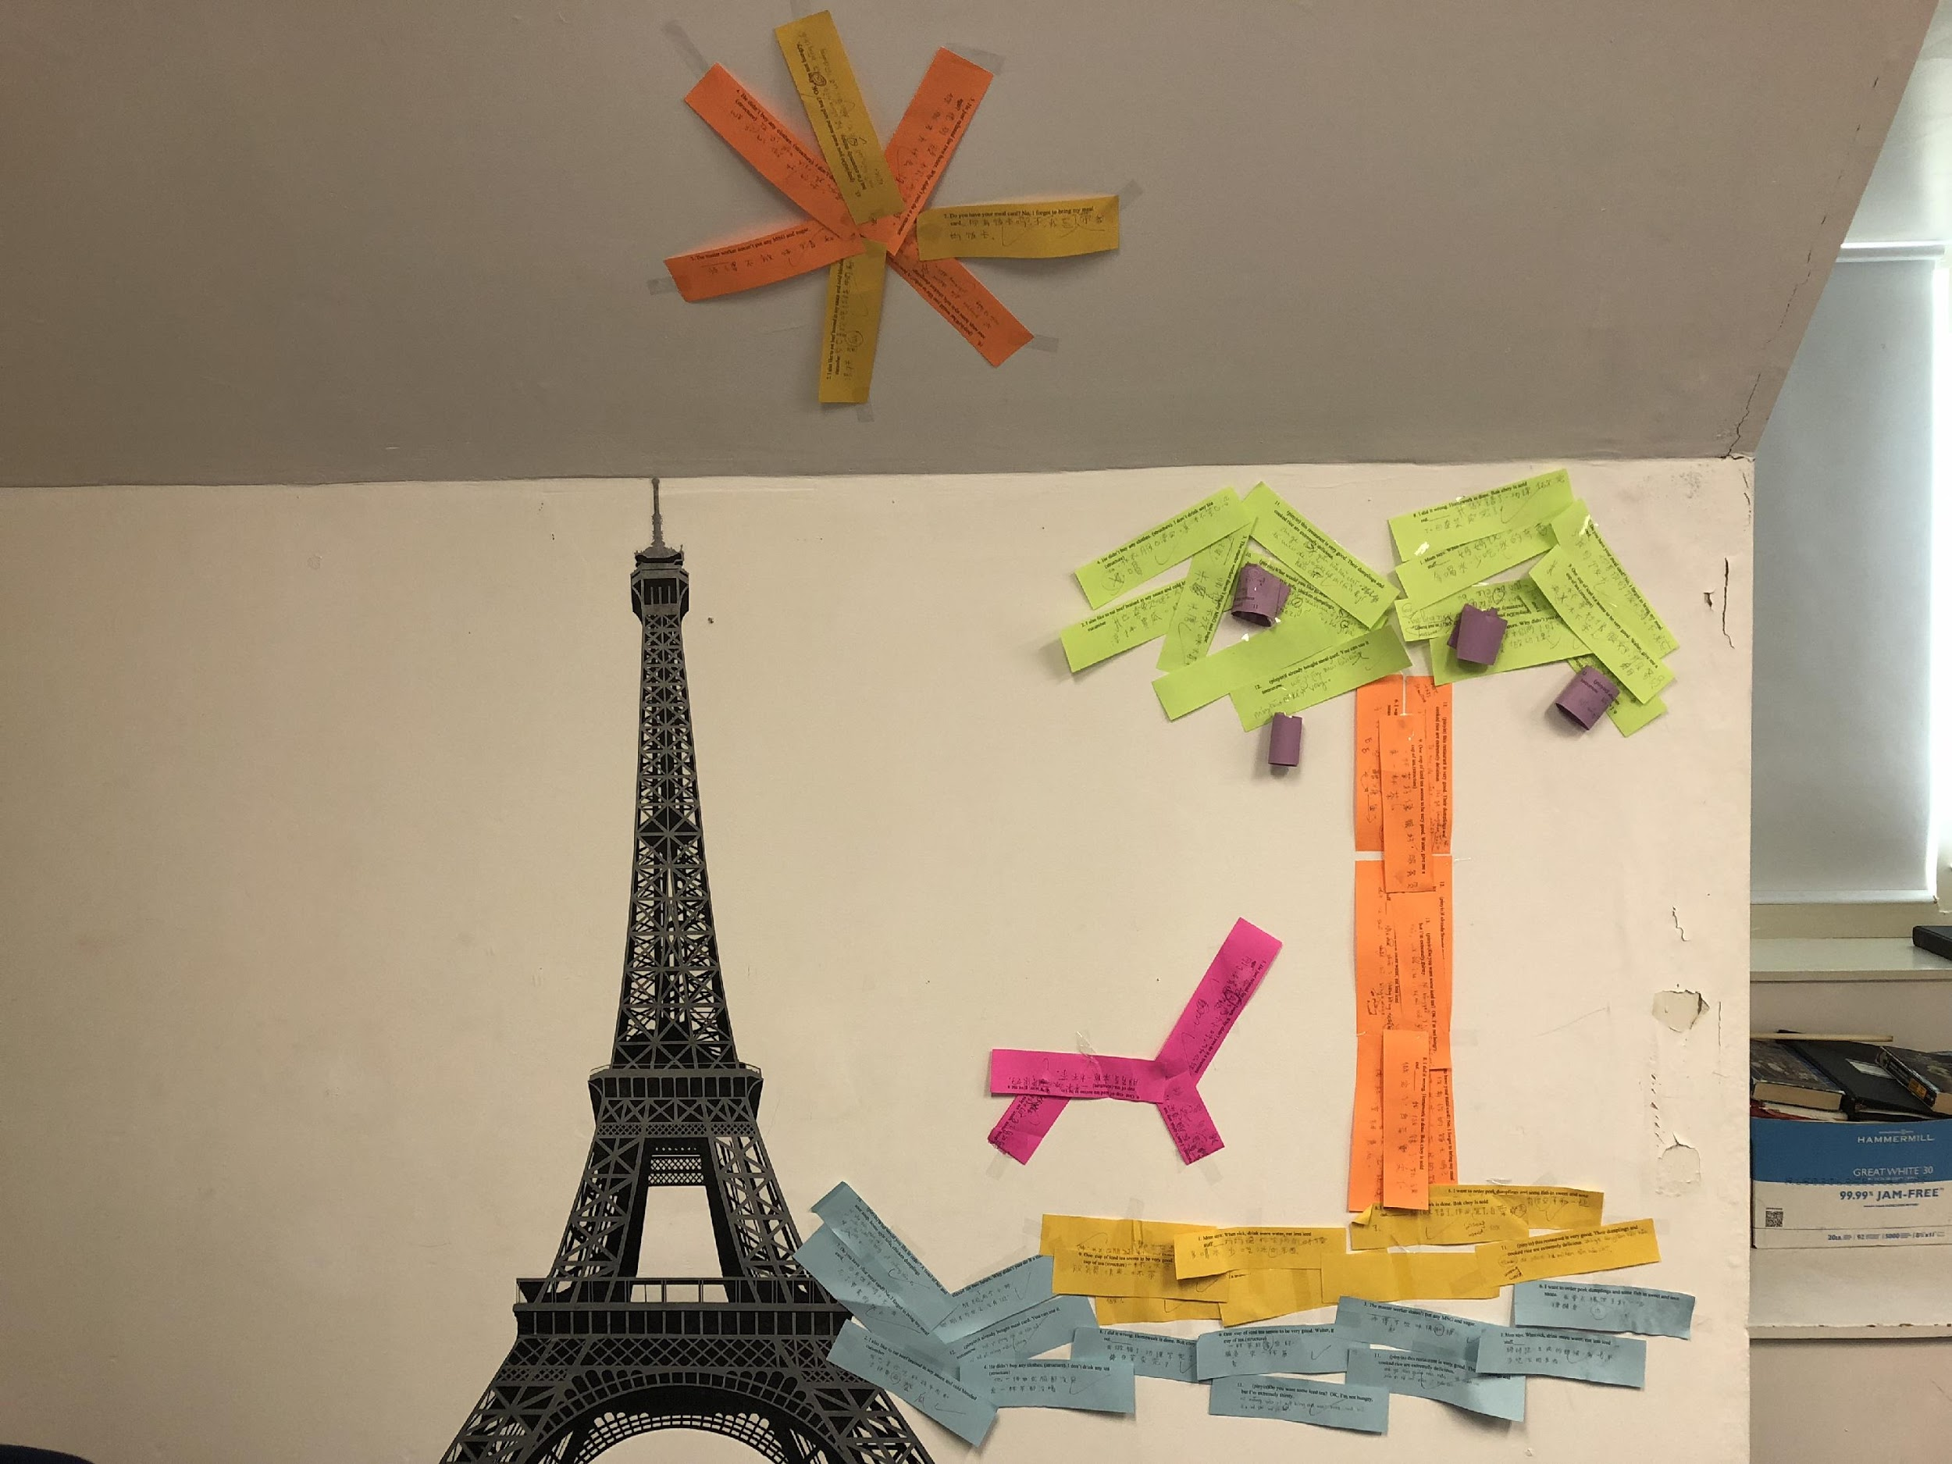

Slide 12
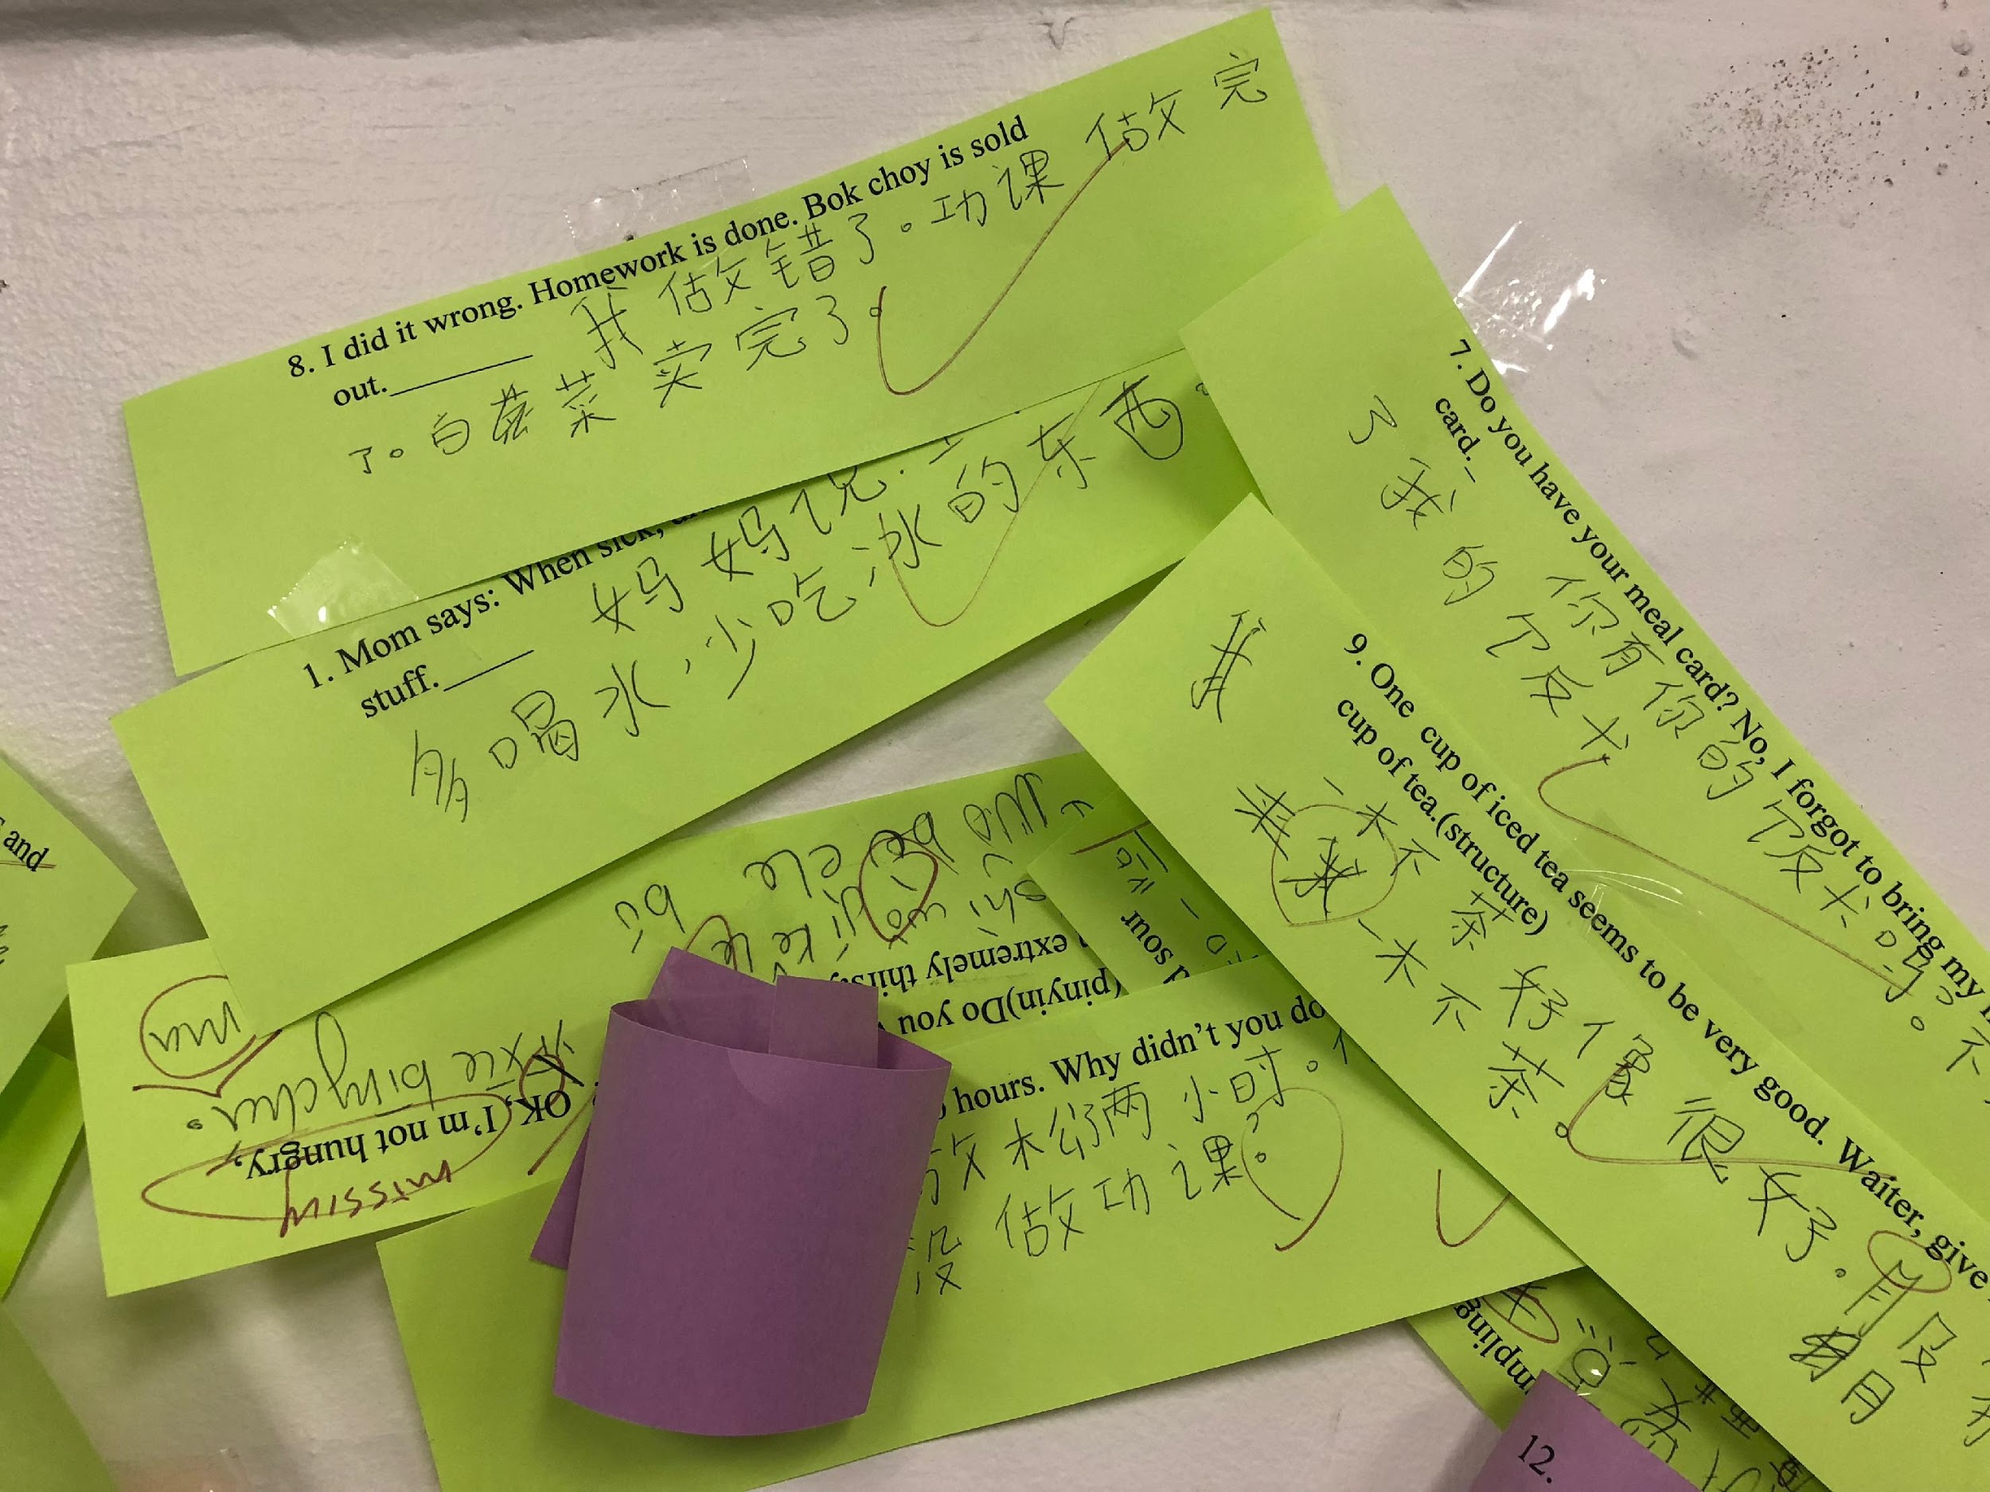

Slide 13
Pictionary/ Draw and Guess
Suitable for vocabulary
Get team names to keep score
Back row draws
front row guesses
Back row raises hands

Slide 14
Index Card Game
Suitable for vocabulary
2 Teams
Where is the hand?
Who is the judge?
Pet talk for rock paper scissors
If there are two raising hands in one team, they automatically lose

Slide 15
Name 5 Things
Suitable for reviewing vocabulary in general
Groups of 5
Everyone in the group need to raise hand to get priority
After raising hands, no more discussion
When there is a repeat or hesitation, the next team can steal the point

Slide 16
Hot Potato
Suitable for reviewing vocab in general
Hot potato in your hand no more than 5 seconds
If no answer or repeat answers, you kneel down/out of the game
To be more challenge, say two things at once
Game stops when more than half or 1/3 are out of the game
Let’s try: For example: certain categories such as fruit, countries, nouns, verbs, words with “a” in pinyin, etc.

Slide 17
High Five: Ask Ask Exchange
Suitable for open ended questions that can boost short discussion
Let’s try: Write down questions, such as what do you like about teaching? What’s your favorite class activity? What do you like to eat?
When available, raise hand to get a fancy high five. After talking, exchange the cards with each other, and then move on to next available partner
An example of fancy high five.

Slide 18
Listening: Chain of the Story
Play it for 2 or 3 times in total, and then ask questions for their listening comprehension
Time it! So students have motivation to fully engage and try their best

Slide 19
Q&A
Sheng-Chu Lu
slu@pingree.org

