Slide 1
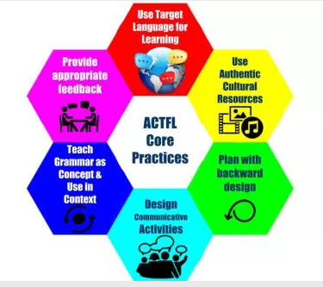
ACTFL's Core Practices for Effective Chinese Learning
ACS 45th Conference
Presenter: Dr. Yu-Lan Lin

Slide 2
By the end of the Session
I can:
Define Core Practices in teaching of World Languages
Explain the significance of enacting the ACTFL Core Practices
Tell the “small grains” in each of the six ACTFL Core Practices
Follow the “teaching moves” identified in each of the small grain.
Notes:
Intro background

Slide 3
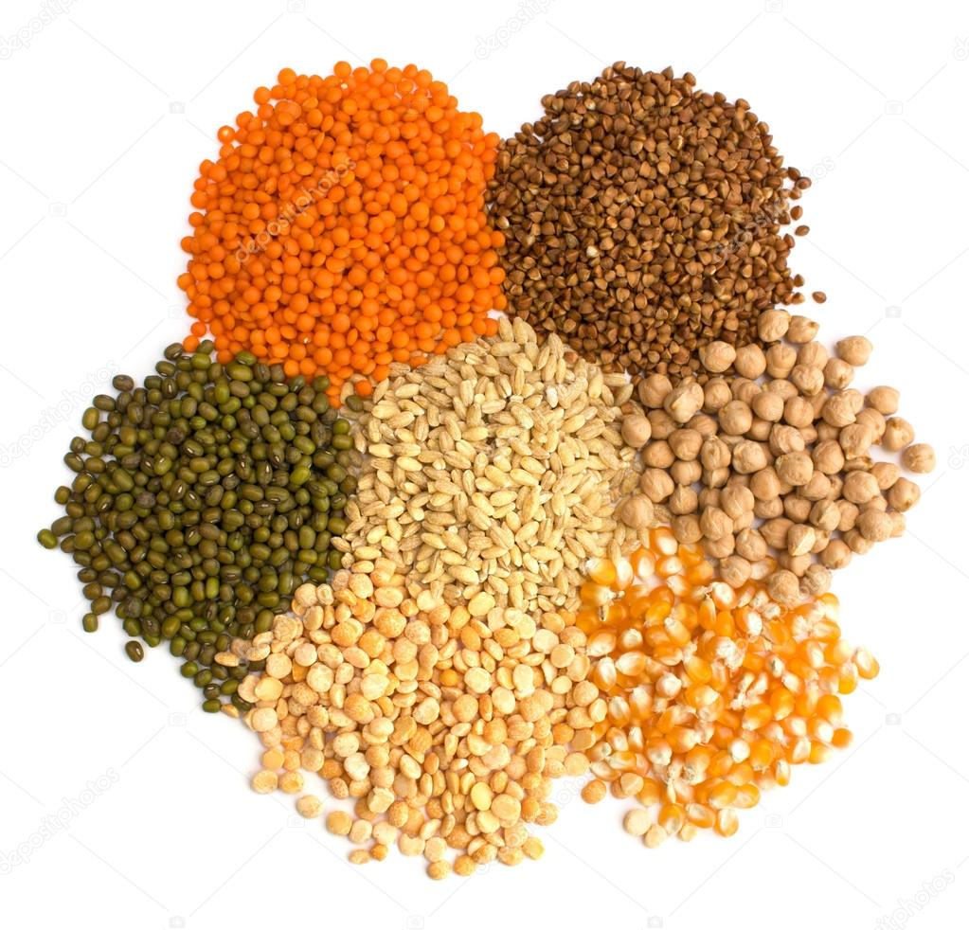
ACTFL’s 6 Core Practices
Use Target Language for Learning
Design Communicative Activities
Plan with Backward Design Model
Teach Grammar as Concept
and Use in Context
5. Use Authentic Cultural Resources
6. Provide Appropriate Feedback
Large-Grain
Core
Practices

Slide 4
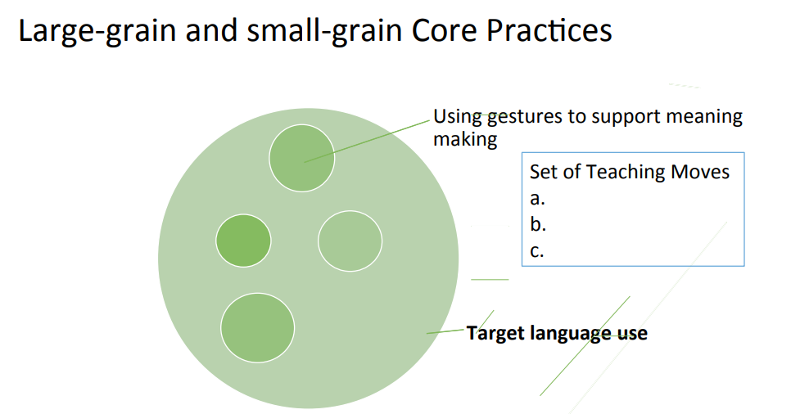
Slice of a Core Practice 1
Small grains

Slide 5
“Set of Teaching Moves” examples:
In the “small-grain” practice: Using gestures to support meaning making, set of teaching moves could be:
1) T says, 聽老師說 ,getting attention
2) T says,請大家把功課拿出來 ， using gestures
3) T says, 從後面一個一個傳過來, using gestures
4) T provides reactions/feedback to reinforce meaning: 很好，還有誰還沒交功課？

Slide 6
Core Practice #1
Use Target Language for Learning
1. Use TL maximum
2. Offer structure & support
3. Create a need and purpose to use TL
1
2
3

Slide 7
Grain 1: Use target language maximum possible
Teaching Moves:
1. T creates comprehensible language
2. T creates contexts for comprehension
3. T creates comprehensible interactions
between students

Slide 8
Grain 2: Offer structure and support
Teaching Moves:
1. T uses conversational strategies
2. T provides feedback and follow-up
3. T offers students ‘license’ to make errors

Slide 9
Grain 3: Create a need and purpose to use TL
Teaching Moves:
1. T creates a task that relates to real-life situations ( Task: Celebrate the Earth Day)
2. T pairs up students for interactions
3. Have students negotiate meaning to work on information

Slide 10
Core Practice #2
Design Communicative Activities
1.Listen to one another
2.Negotiate and interpret
meaning
3. Avoid communication breakdown by clarifying meaning
1
2
3

Slide 11
Grain 1: Listen to one another
Teaching Moves:
1. T designs a task with a purpose in mind ( sharing:一件難忘的事)
2. Have students take turns exchange information
3. Have students pay attention to meaning
Notes:
Have 2 participants demo

Slide 12
Grain2: Negotiate and interpret meaning
Teaching Moves:
1. Have students activate background knowledge
2 Have students relate new information to one’s own 3. Have students use context clues to interpret meaning

Slide 13
Grain 3: Avoid communication breakdown by clarifying meaning
Teaching Moves:
1. Students use strategies to fill in information gap
2. Teacher checks for understanding/provides support
3. Students manage to follow up on information exchange

Slide 14
Core Practice #3
Plan with Backward Design Model
1. Set the end goals
2. Determine acceptable
evidence
3. Plan learning activities
1
2
3

Slide 15
Grain 1: Set the end goals
Teaching Moves: ( Theme: Technology in My Life)
T identifies functional goals and objectives
T identifies main concept and enduring understanding
T provides key questions that lead to enduring understanding for students
Notes:
1. What can technology do in my life/2. make good use to enhance my life/3 how does technology influence your life?

Slide 16
Grain 2: Determine acceptable evidence
Teaching Moves:
1. T designs formative assessments to monitor progress
2. T design a culminating activity as summative assessment.
3. T designs rubrics that contain assessment elements

Slide 17
Grain 3: Plan learning activities
Teaching Moves:
Phase 1: “I do”
Phase 2: “We do”
Phase 3: “You do together”
Phase 4: “You do alone”

Slide 18
Core Practice #4
Teach Grammar as Concept and Use in Context
1. Focus on meaning before form
2. Conceptual
understanding of form
3 Motivation is key to
grammatical competence
1
2
3

Slide 19
Grain 1: Focus on meaning BEFORE form
Teaching Moves:
1. T presents of a story with gestures and props
2. T directs students’ attention to some aspects of the story
3. T asks students to recall/tell parts of the story
Notes:
除了。。。什么也没有/说着。。就出发/

Slide 20
Grain 2: Conceptual understanding of form
Teaching Moves:
1. T highlights a form/particular structure for student to focus.
2. T and students engage in discussion of grammar points
3. T uses assisting questions to help students discover
patterns.
Notes:
看看抽屉里有什么？

Slide 21
Grain 3: Motivation is key to grammatical competence
Teaching Moves:
1. T finds ways for students to find meaning in the
form
2. Have students use the form in creative and
new ways to make meaning.
Notes:
你的口袋里有什么？

Slide 22
Core Practice #5
Use Authentic Cultural Resources
1. Literal and inferential
comprehension
2. Interacting with texts
3. Use authentic texts
1
2
3

Slide 23
Grain 1: Literal and inferential comprehension
Teaching Moves:
1. T directs students to skim the text
2. T asks students to analyze the text
3. Students in groups discuss the text
4. T ask students to explain the text

Slide 24
Grain 2: Interacting with Texts
Teaching Moves:
1. T activates students background knowledge
2. Have students predict main idea/supporting details
3. T develops guiding questions
4. Have students react/respond to text

Slide 25
Grain 3: Use authentic texts
Teaching Moves:
1. T selects context-appropriate text
2. T selects age-appropriate text
3. T selects linguistic level-appropriate text

Slide 26
Core Practice #6
Provide Appropriate Feedback
1. Use oral corrective feedback
2. Use peer-to-peer feedback
3. Use corrective feedback for writing
1
2
3

Slide 27
Grain 1: Use oral corrective feedback
Teaching Moves:
1. T uses prompts to elicit output
2. T uses reformulations to provide input
3. T uses a variety of corrective methods for feedback
Notes:
要求澄清/诱导出正确的答案/重述/追问/解释

Slide 28
Grain 2: Use peer-to-peer feedback
Teaching Moves:
Have student A ask B, if B doesn’t respond, A gives an example and asks again
Have student A provide a few possible answers to
prompt B

Slide 29
Grain 3: Use corrective feedback for writing
Teaching Moves:
1.T introduces corrective cues
2.T corrects student writing with corrective cues
3. Have students correct errors themselves
Notes:
错字，句型，少了量词，多了字/看不懂

Slide 30
Characteristics of Core Practices
Powerful in advancing student learning
Not transparent or learnable through modeling alone
Complex instructional practices
Must be detailed, deconstructed, and explicitly taught to teachers

Slide 31
Characteristics of Core Practices
Unlikely to be learned well only through observation
Can be assessed
Need to be rehearsed and coached in the specific context
Can be justified as being meaningful and useful for becoming skilled practitioners

