Slide 1
對中文書寫系統的新視野
A New Perspective on the Chinese Writing System and Implications for Teaching Chinese
顧百里 (Cornelius C. Kubler)
美國威廉大學 (Williams College)

Slide 2
中文的書寫系統包括哪些組成部分？
Components of the Chinese writing system
Traditional characters 傳統的中國字: 對 、 國
Simplified characters 简体字: 对 、 国
Alternate characters 異體字: 対、 囯
(or 啤酒 > 啤氿)
Roman alphabet (upper case) 羅馬字 (大寫):
X光 “X-ray,” B型肝炎 “Hepatitis B,” 卡拉OK
“Karaoke,” O 不 OK?,一张CD, O血型, MP3,
3D银幕
Roman alphabet (lower case) 羅馬字 (小寫):
e世代 “digital generation,” n次 “indefinite
number of times”

Slide 3
(components of the Chinese writing system, cont.)
Pinyin romanization system or Chinese phonetic alphabet (for rare characters or character entry)
漢語拼音、注音符號（注音、電腦輸入）
Arabic numbers 阿拉伯数字: 012345679 〇
Mathematical symbols 数学符号 : + – × ÷ = %
Special symbols 特种符号 : ¥ & @ 々
Punctuation 标点符号: 、，；。！？；……
（）「」《》
Spacing conventions
Use of smaller characters for humility, etc.

Slide 4
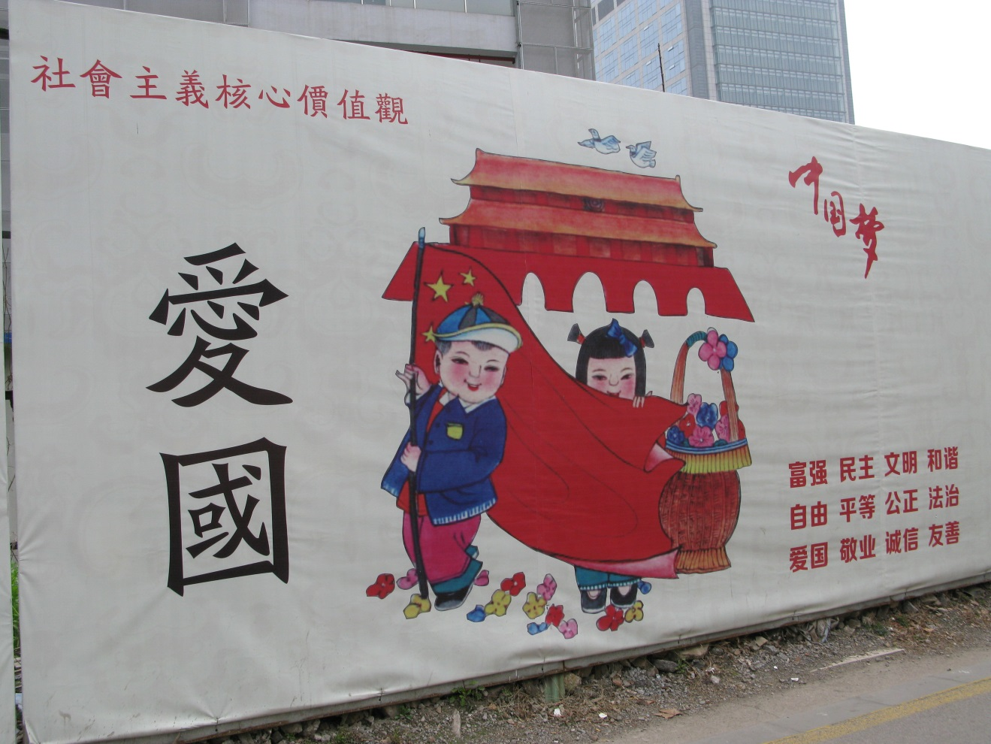

Slide 5
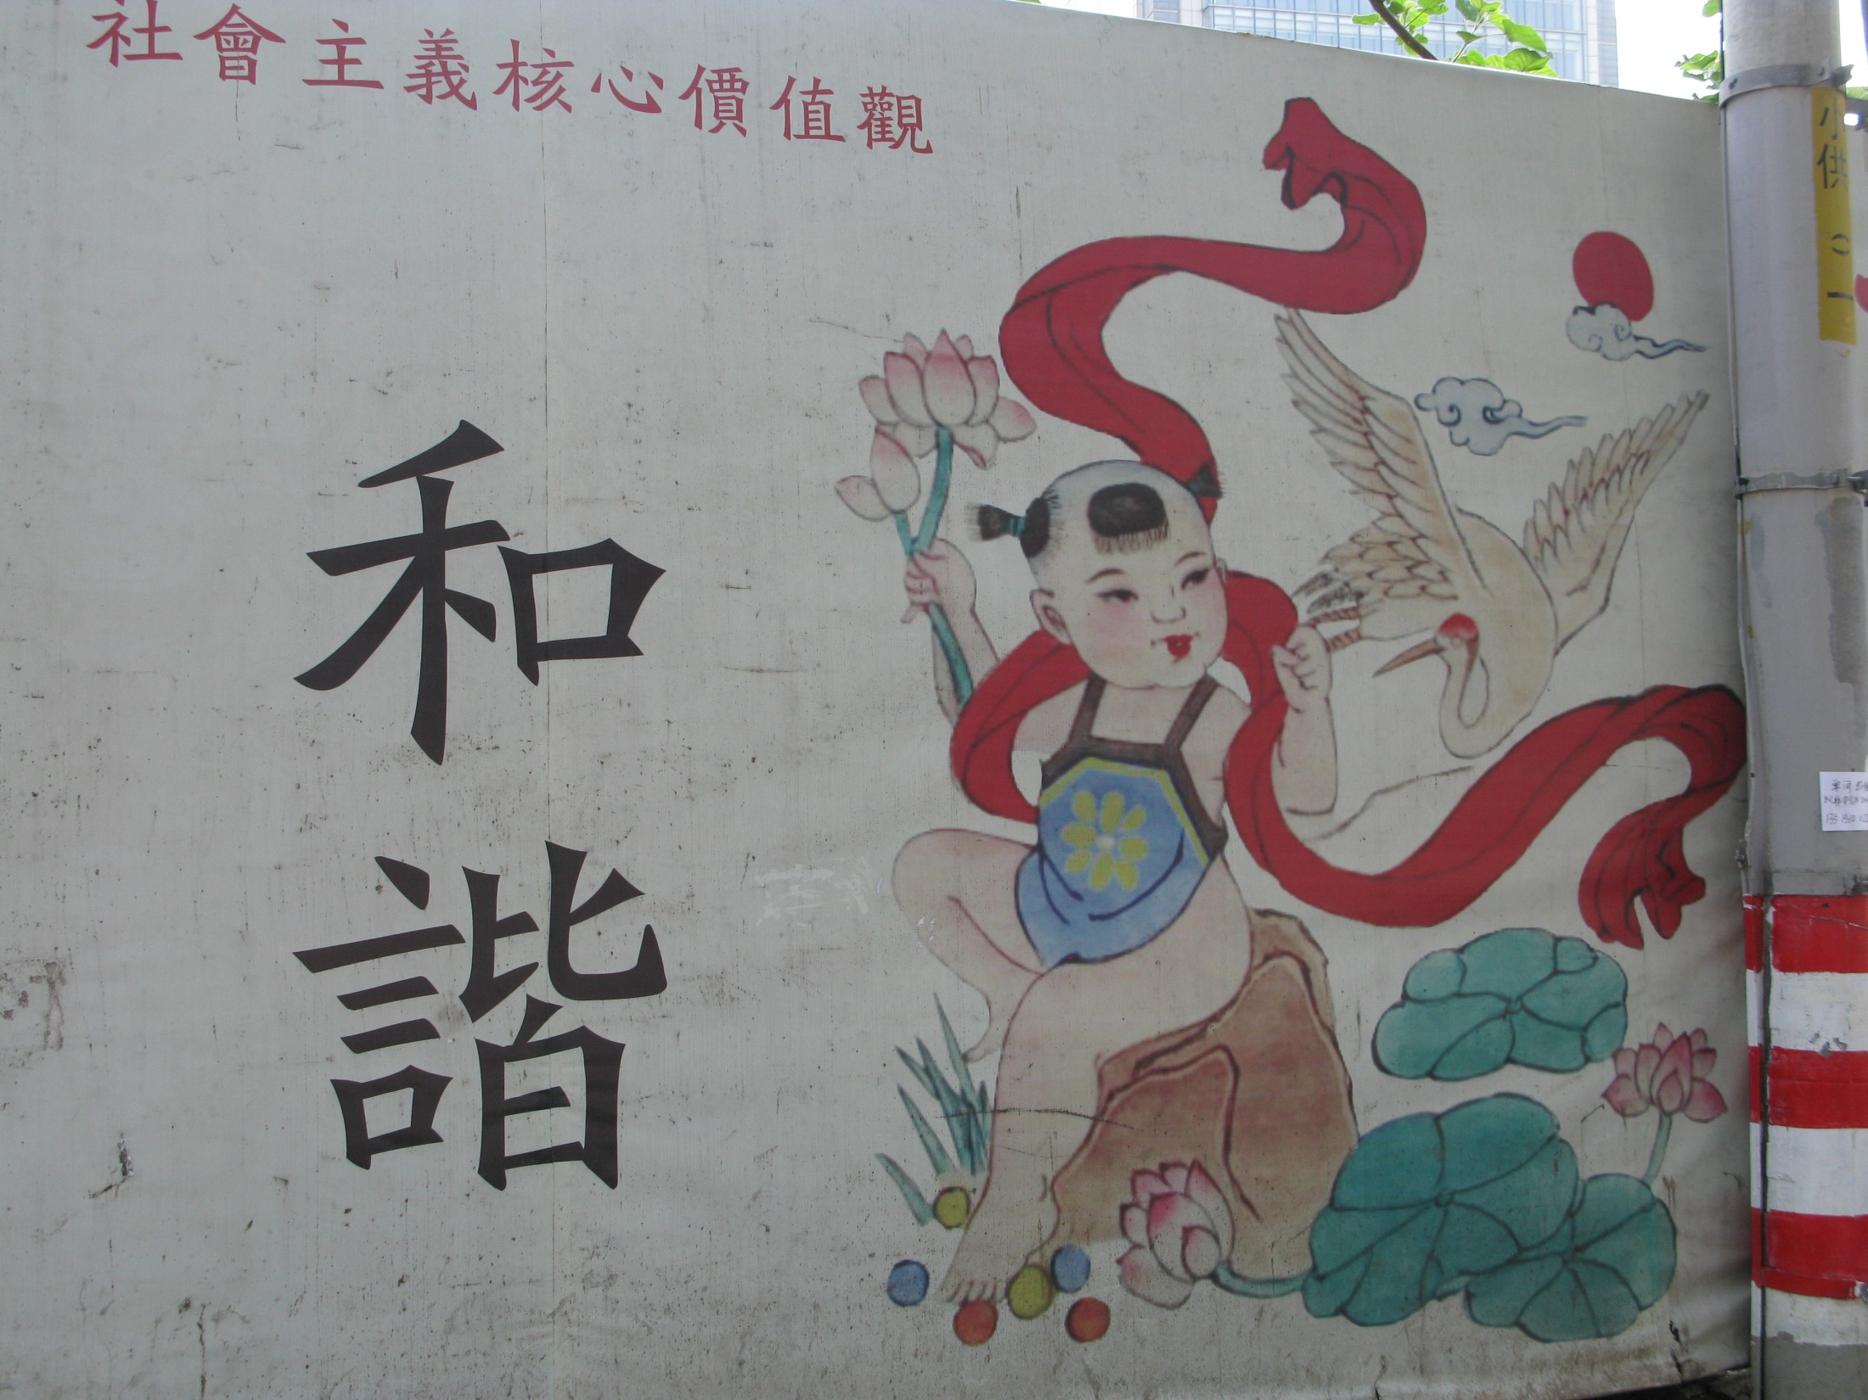
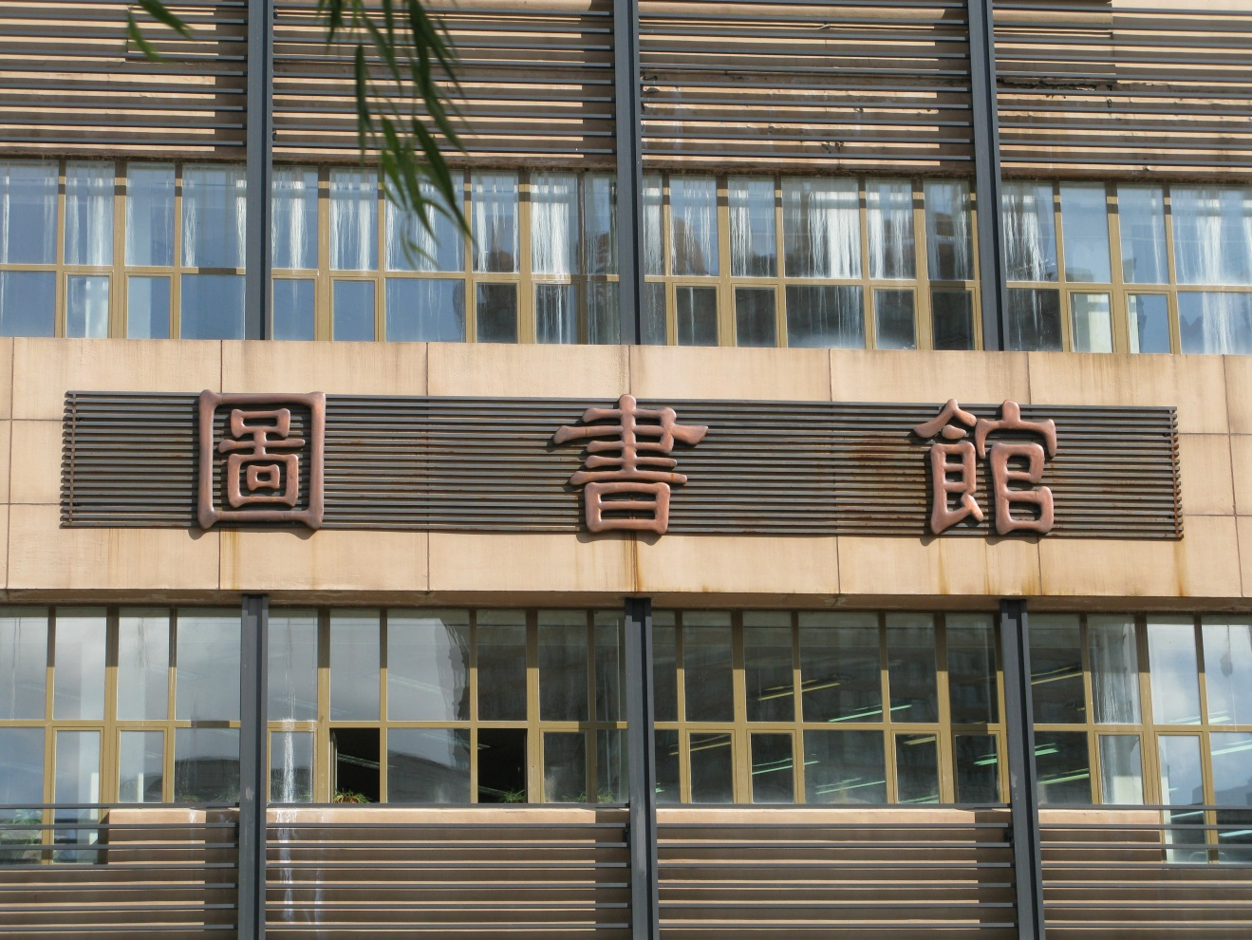

Slide 6
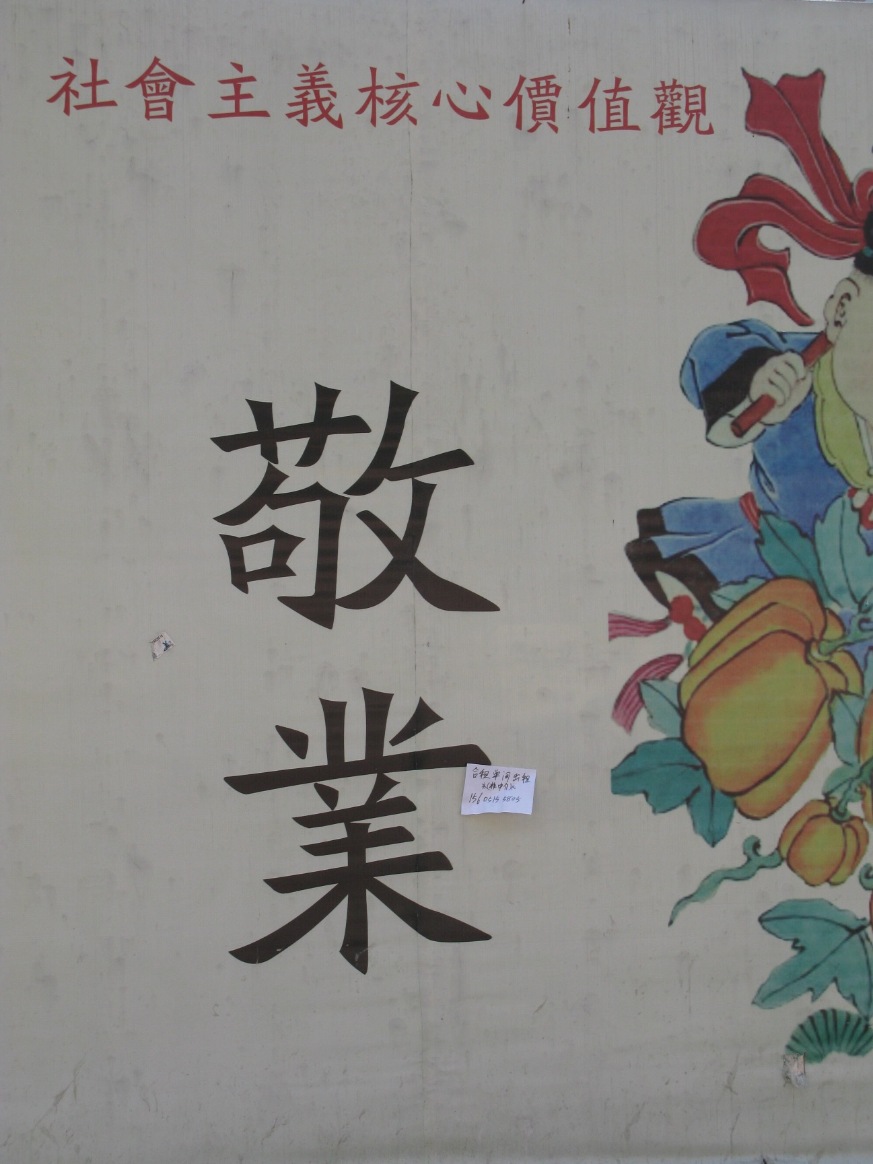
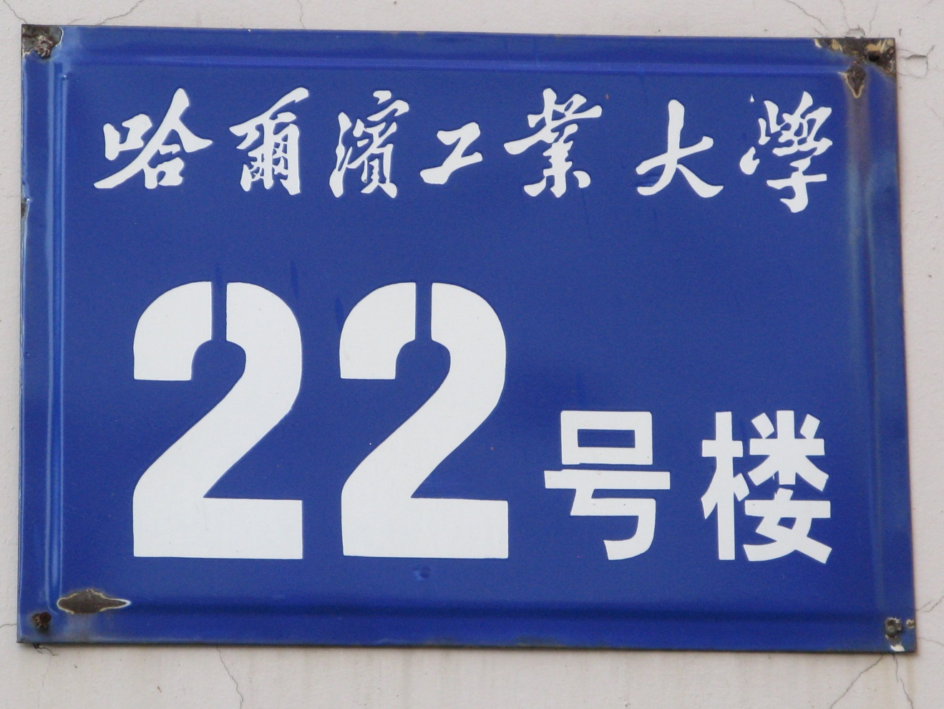

Slide 7
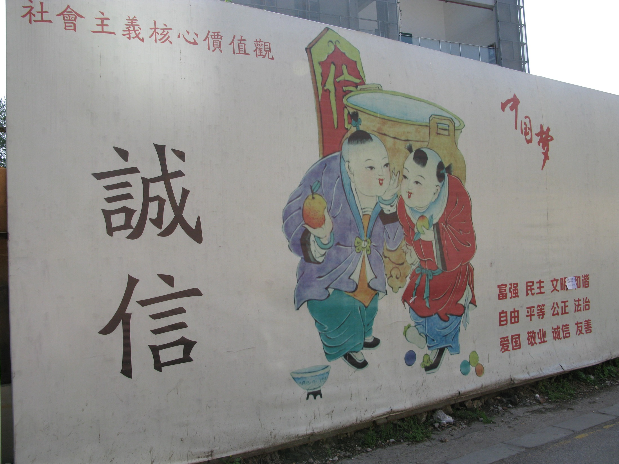
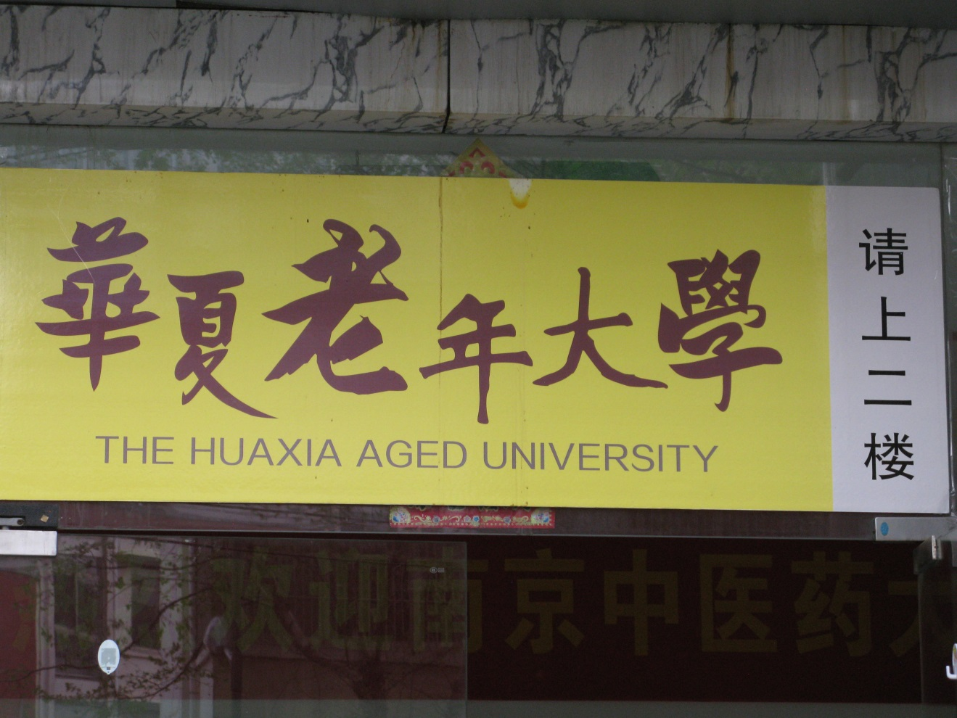

Slide 8
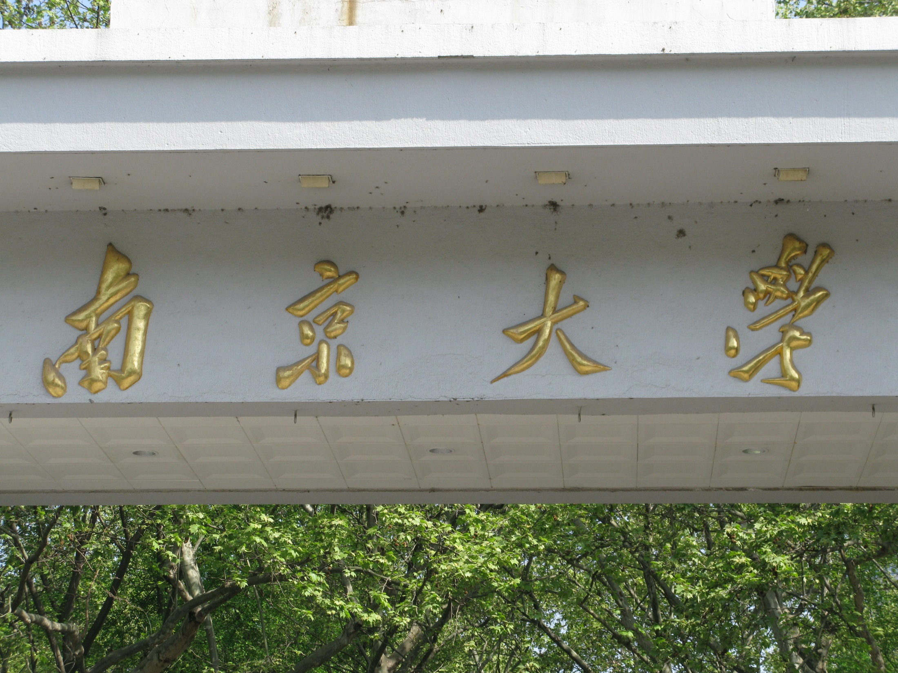
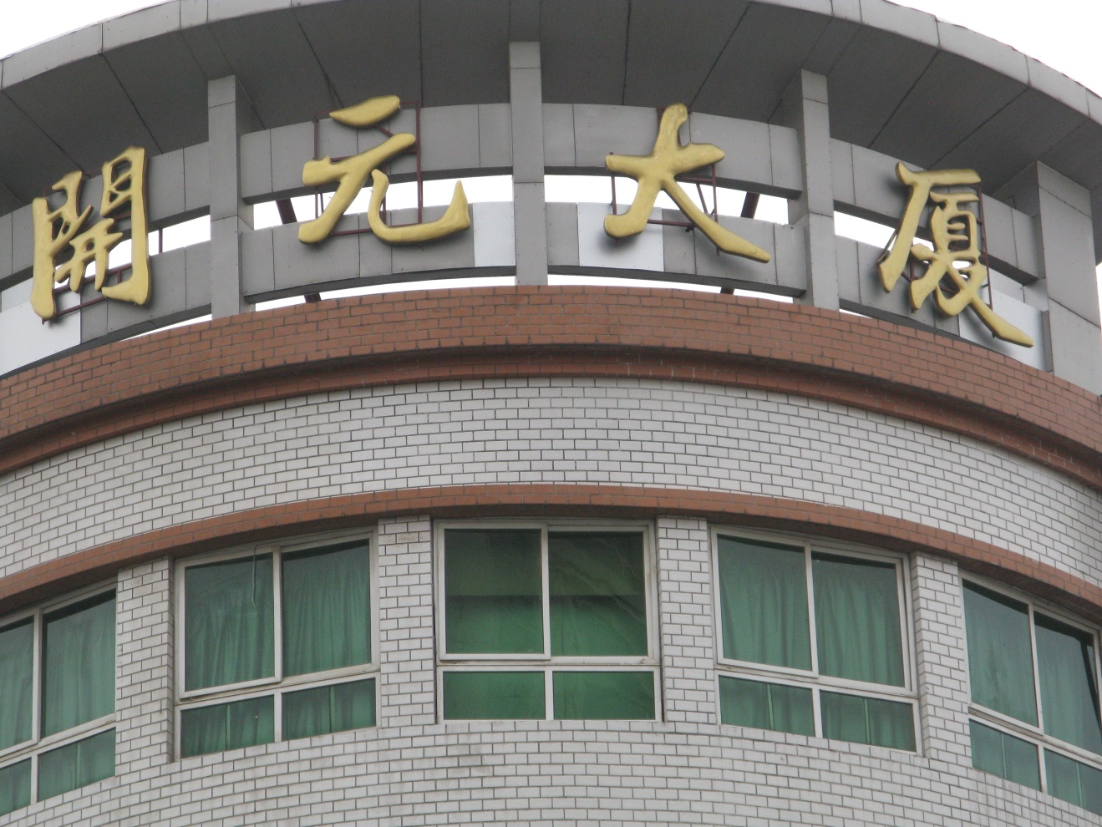

Slide 9


Slide 10
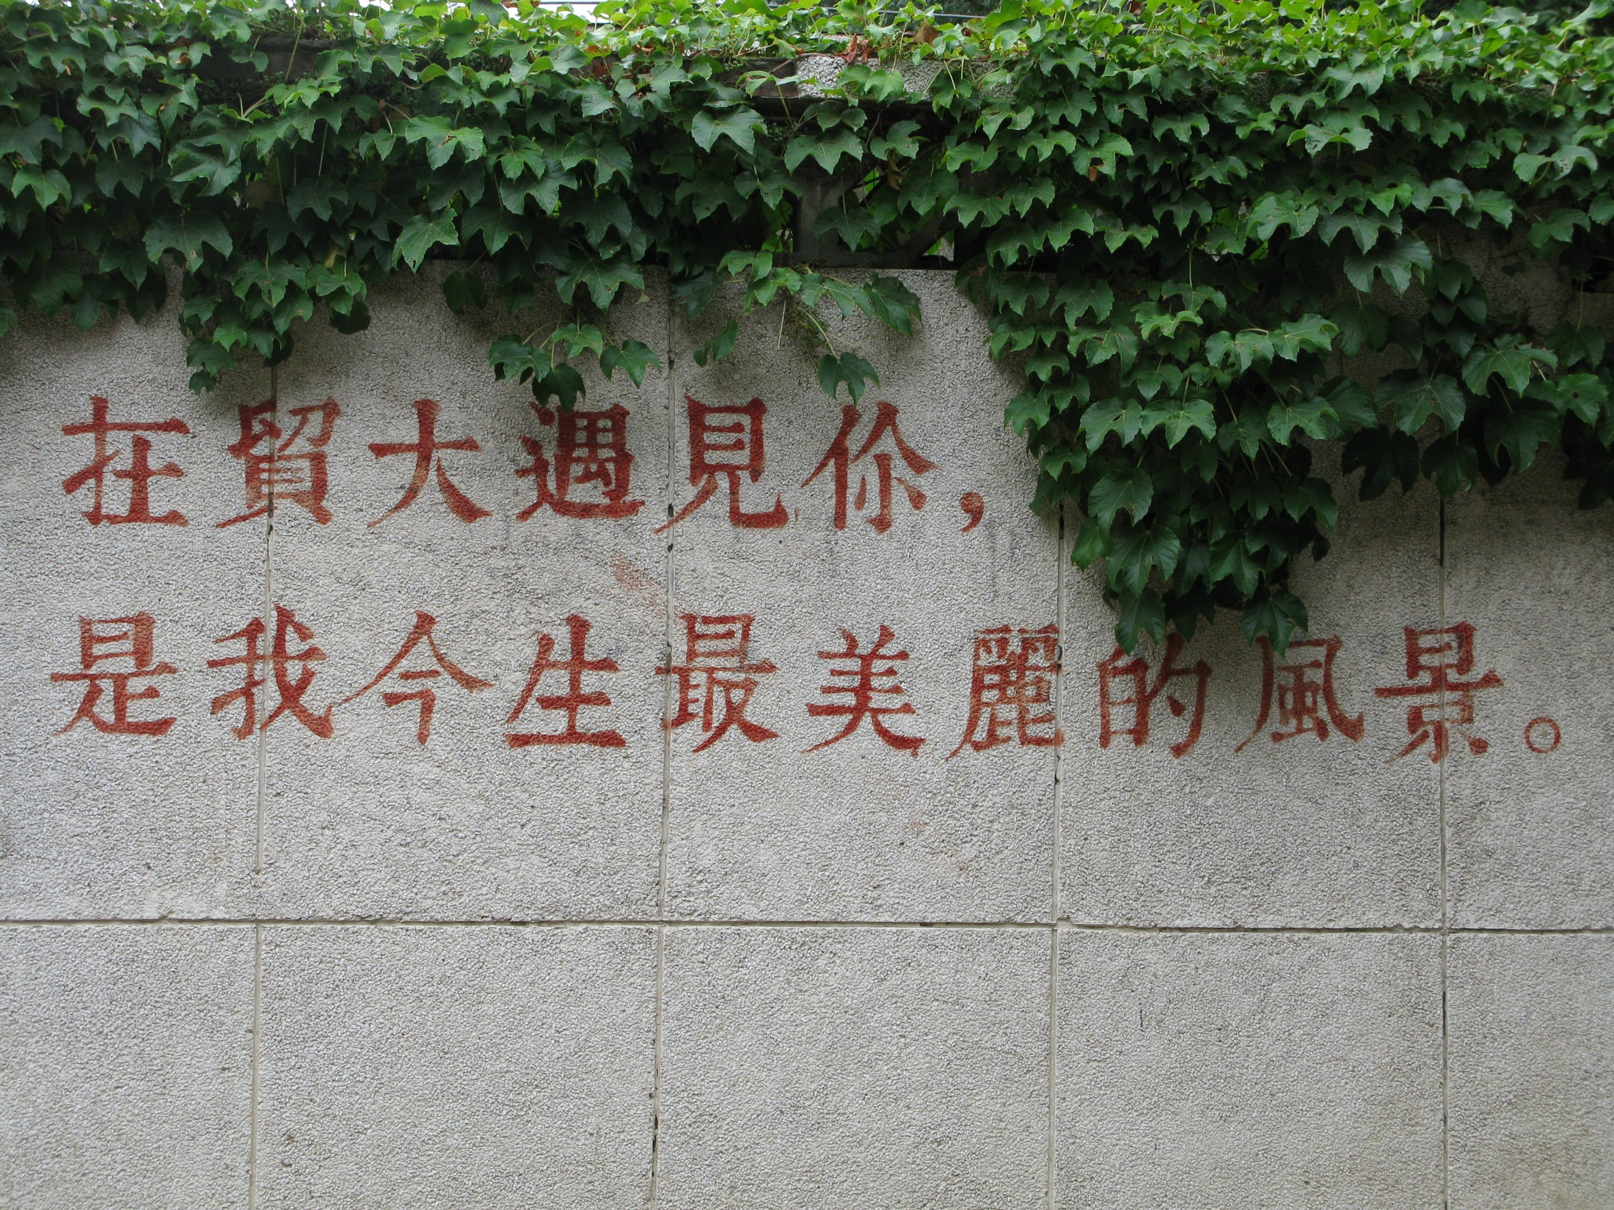

Slide 11
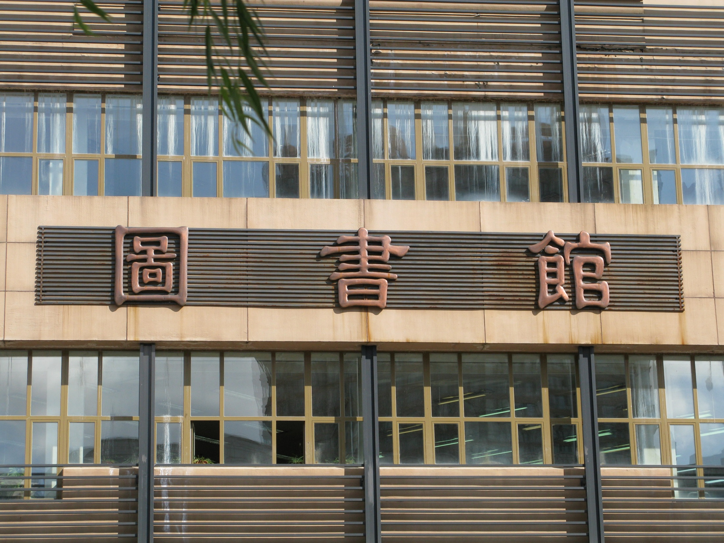
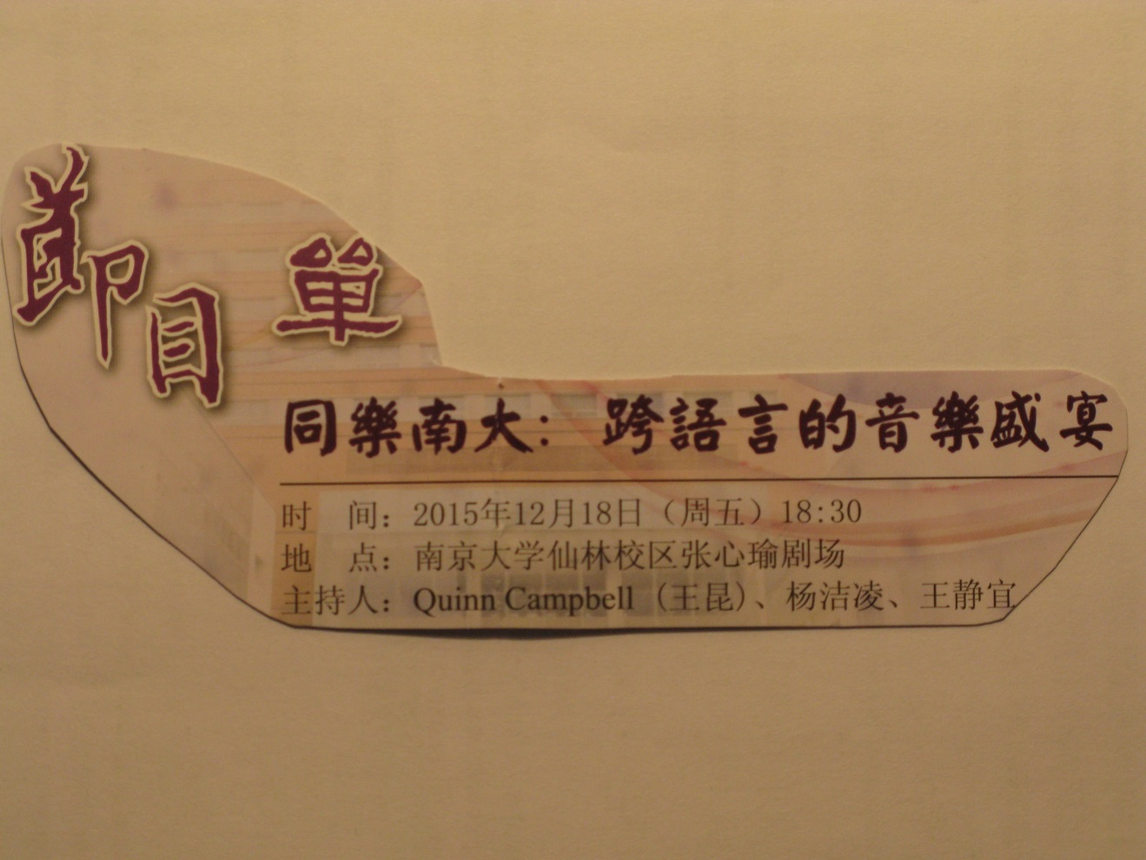

Slide 12
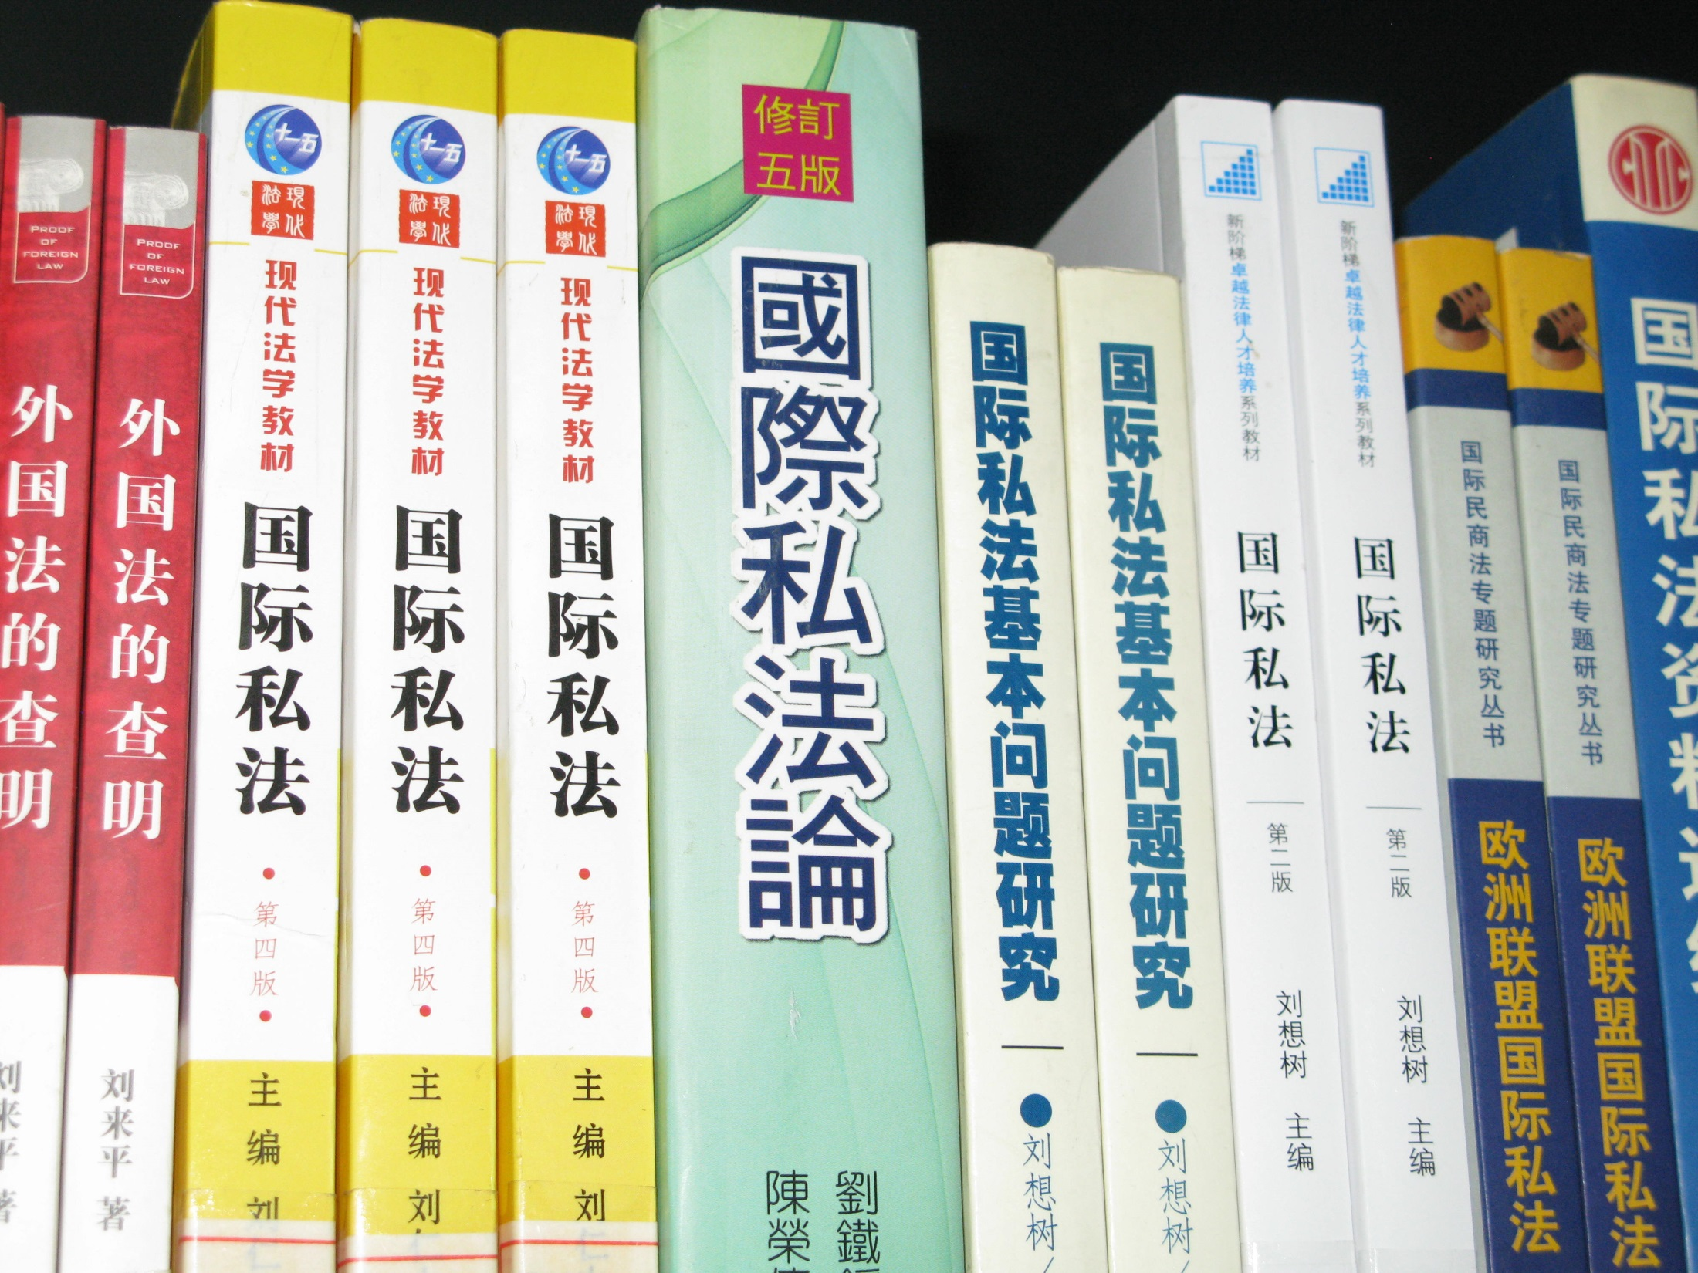

Slide 13
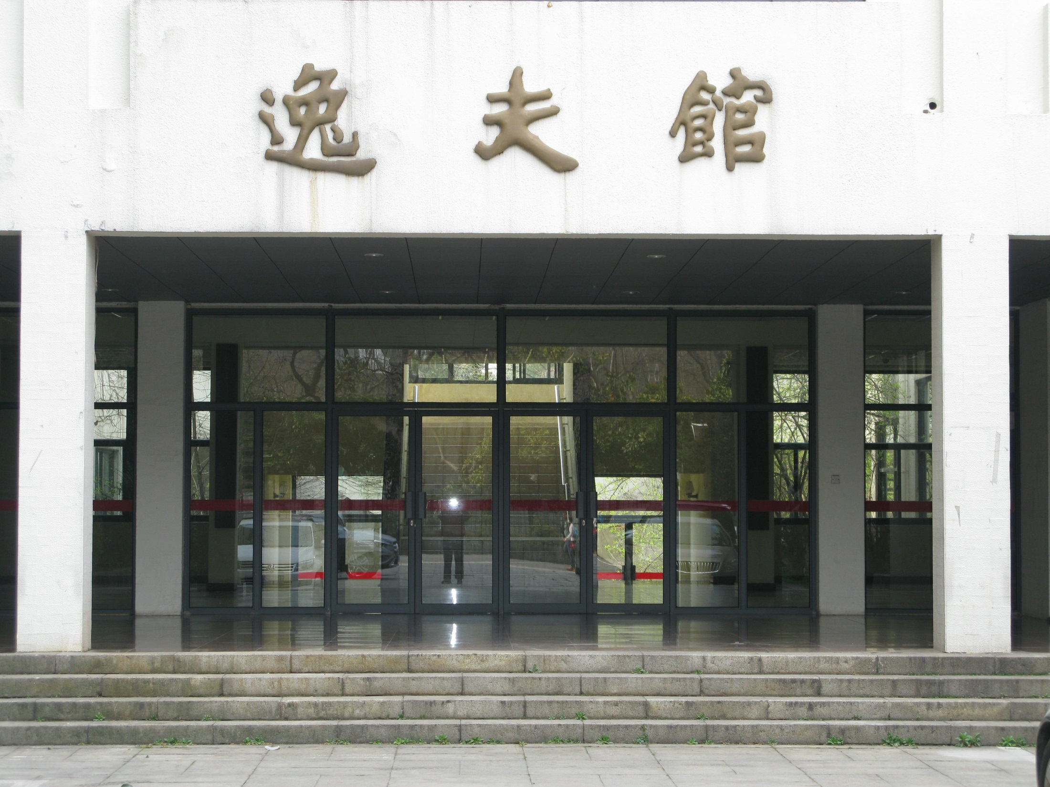
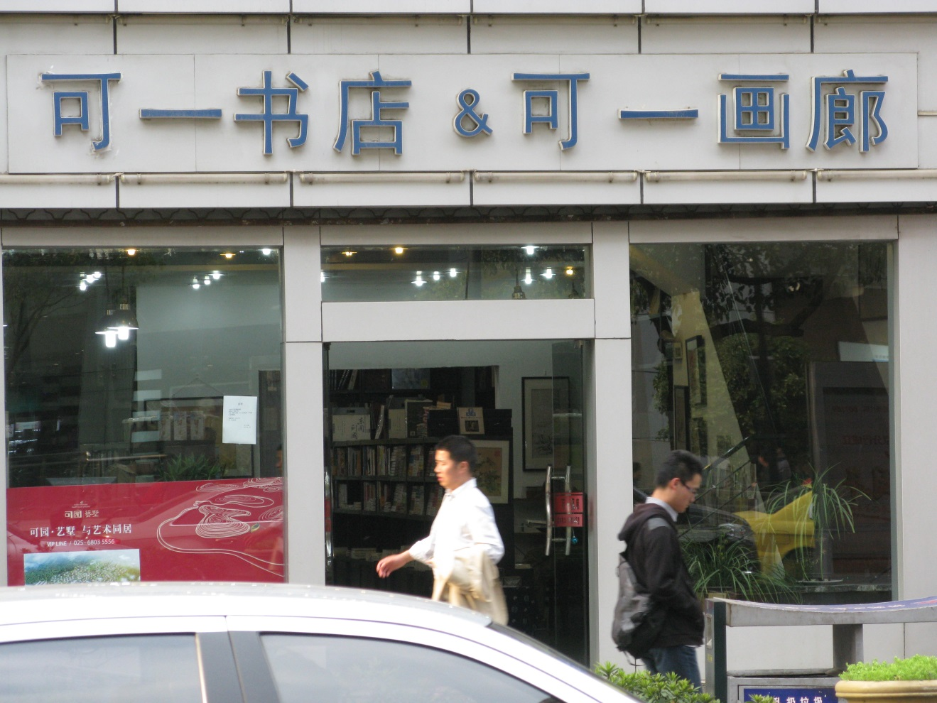

Slide 14
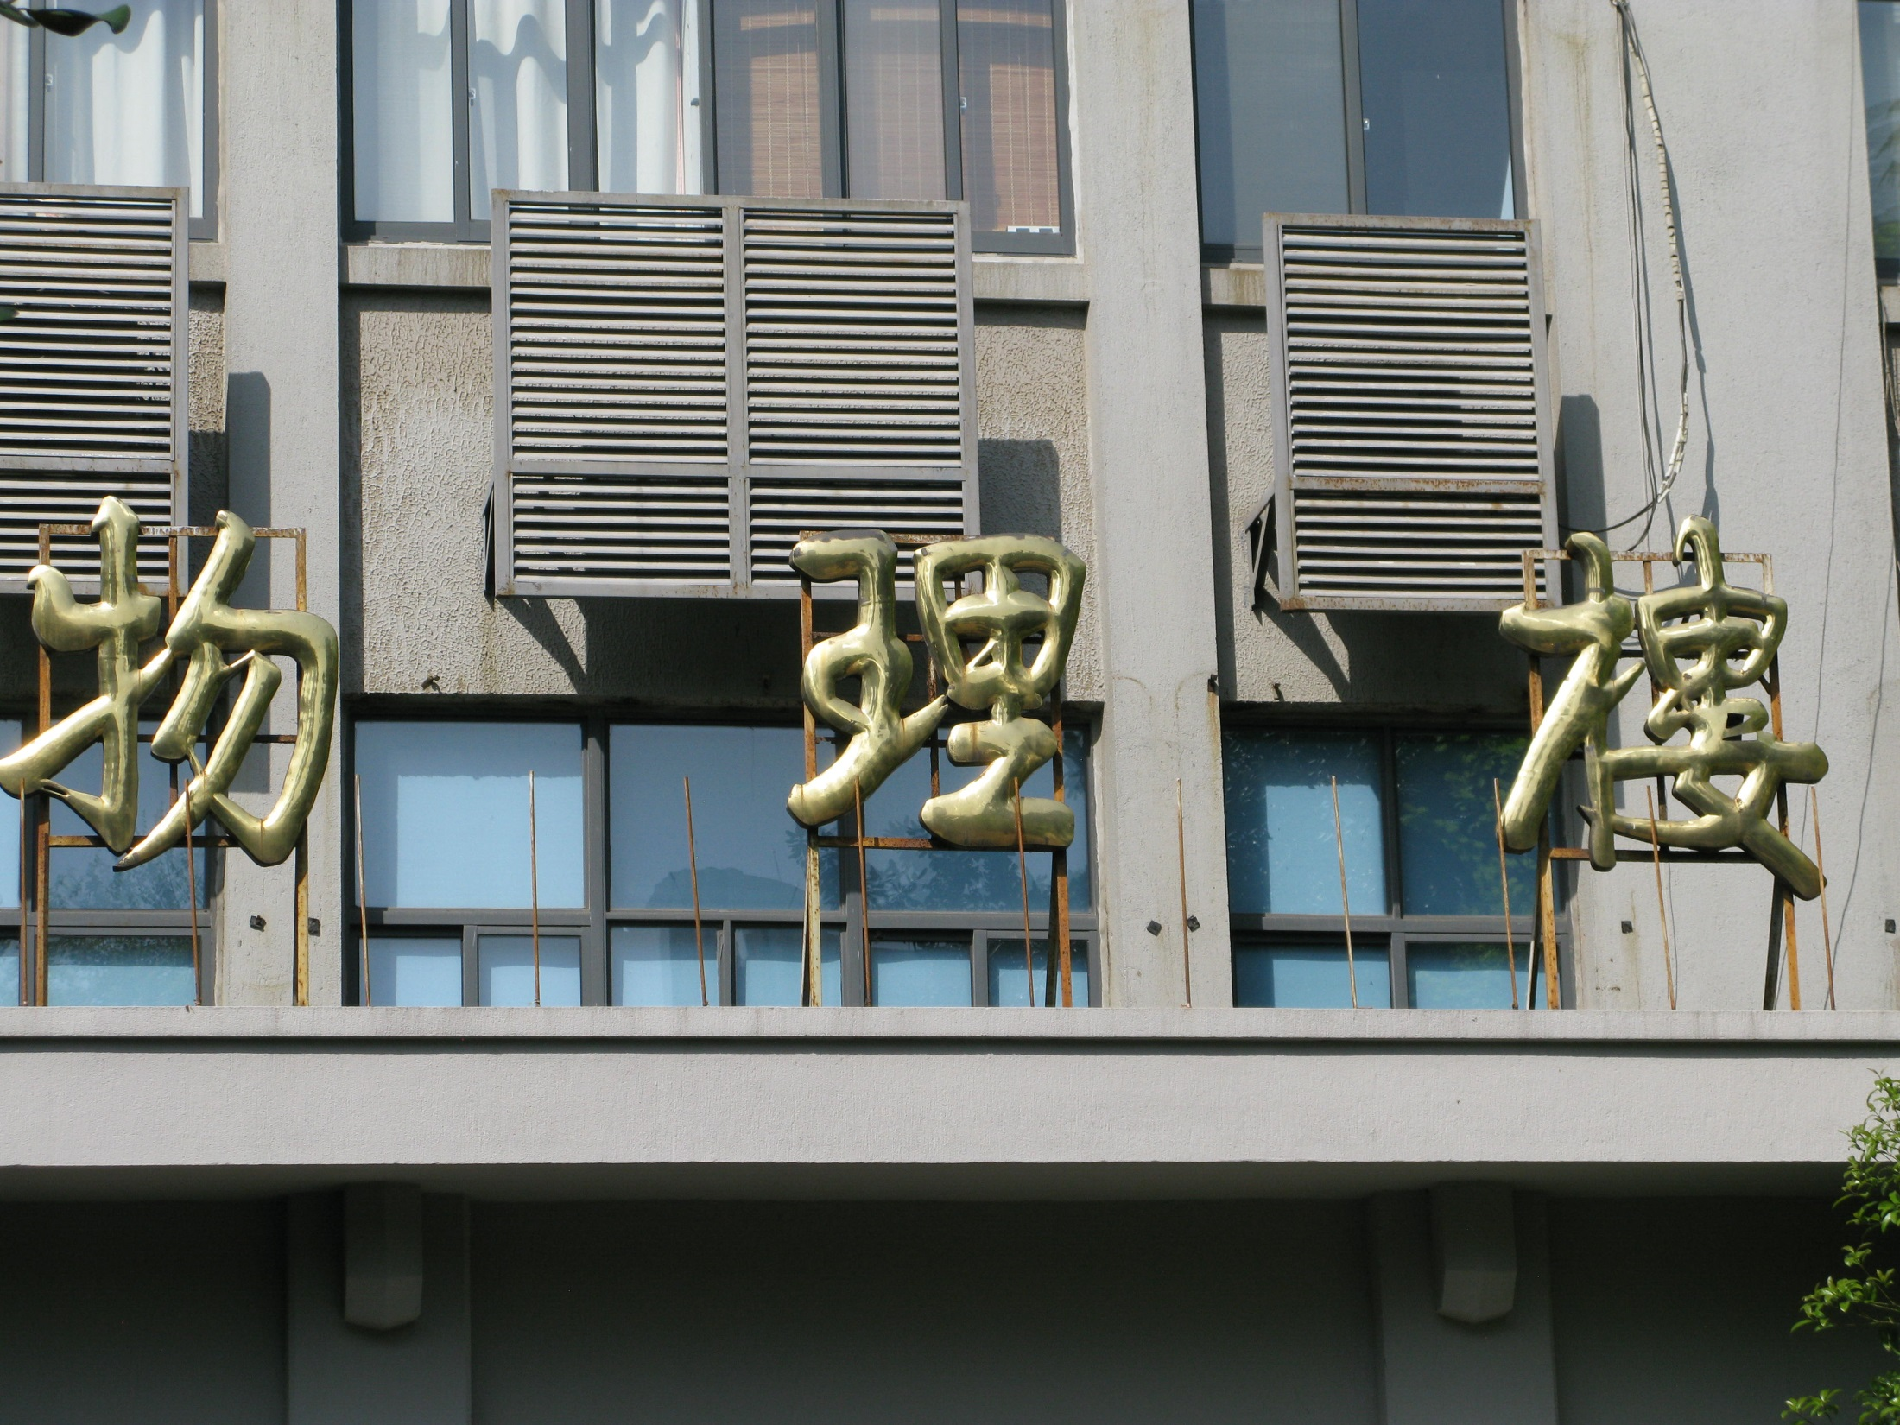
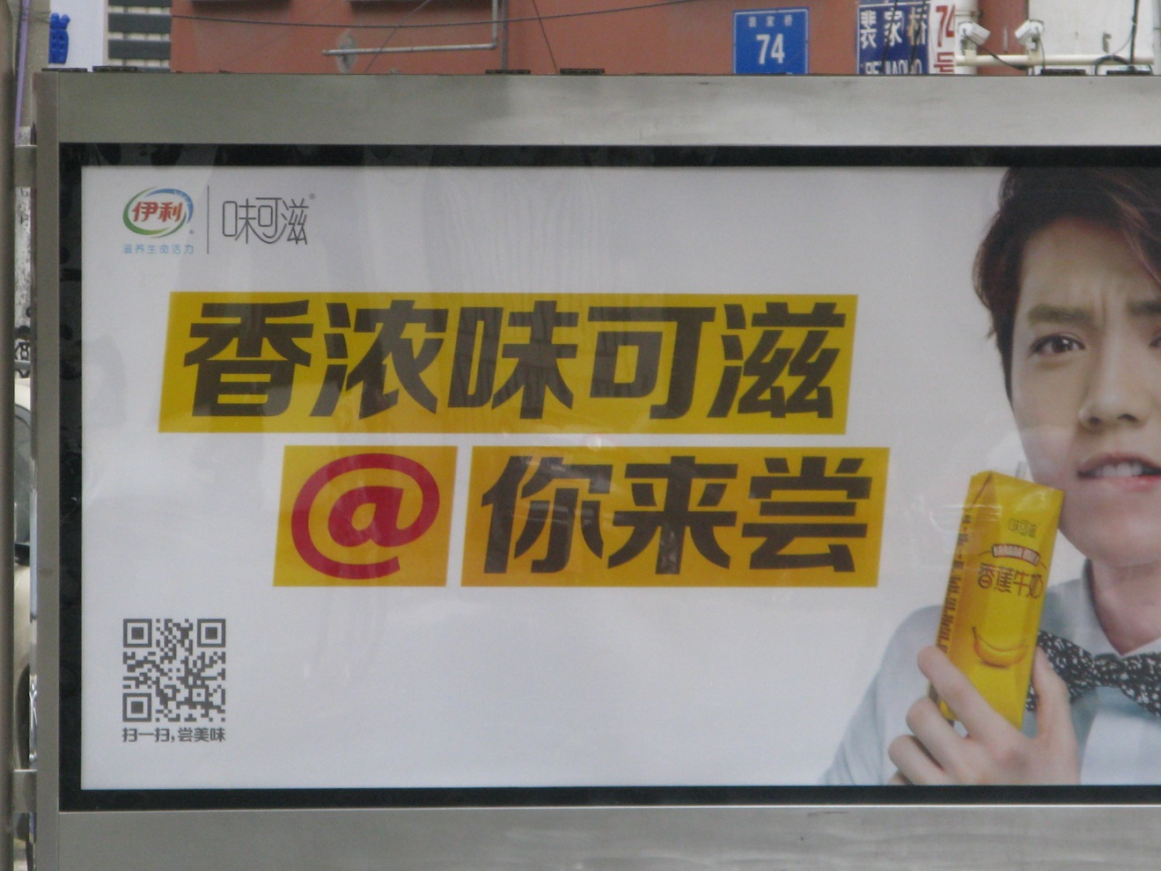

Slide 15


Slide 16


Slide 17
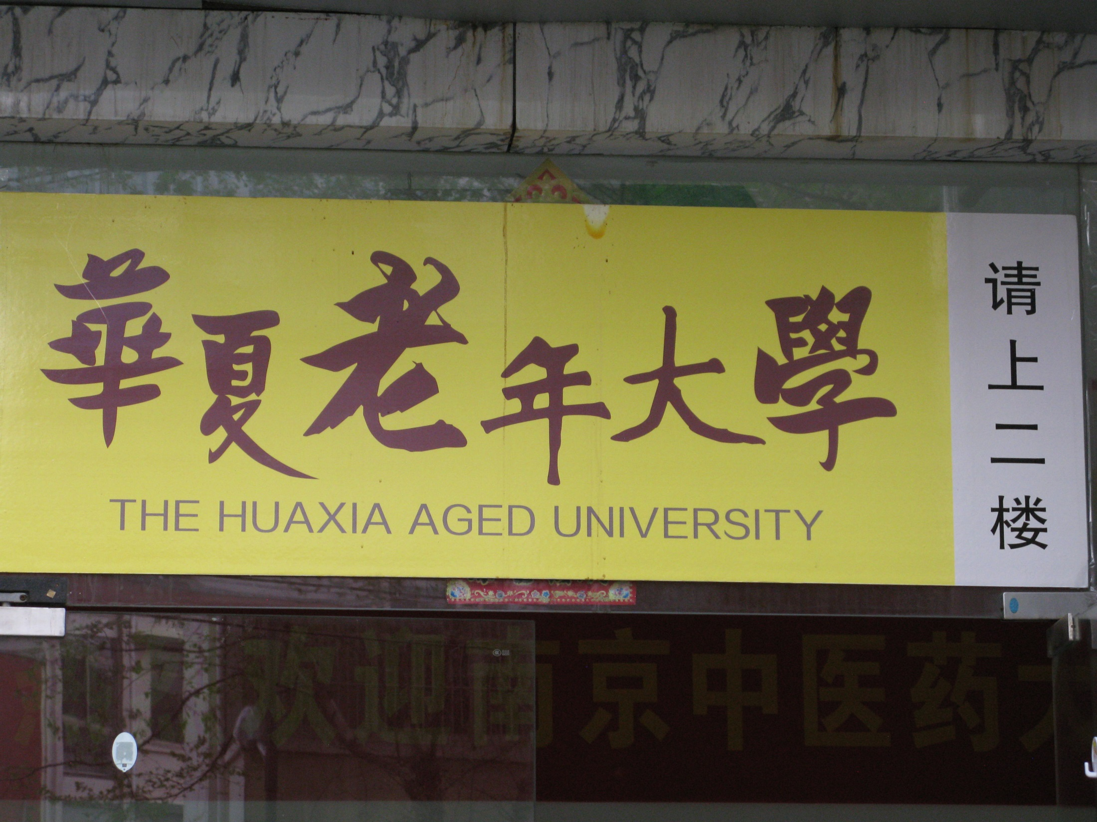

Slide 18


Slide 19


Slide 20
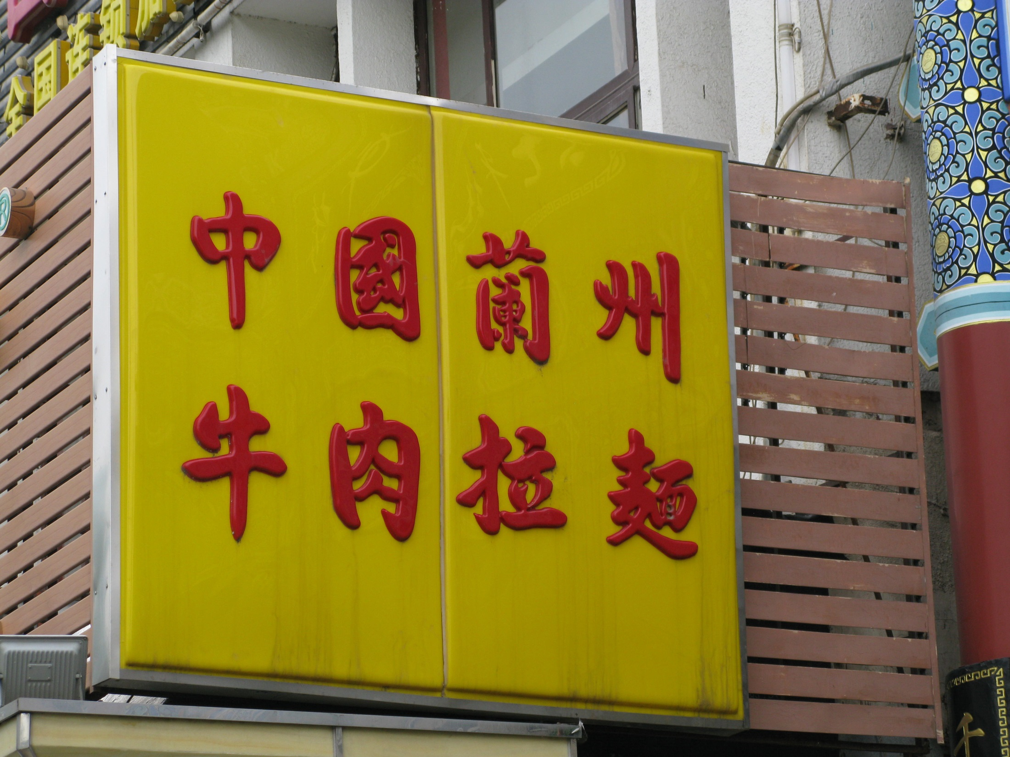

Slide 21
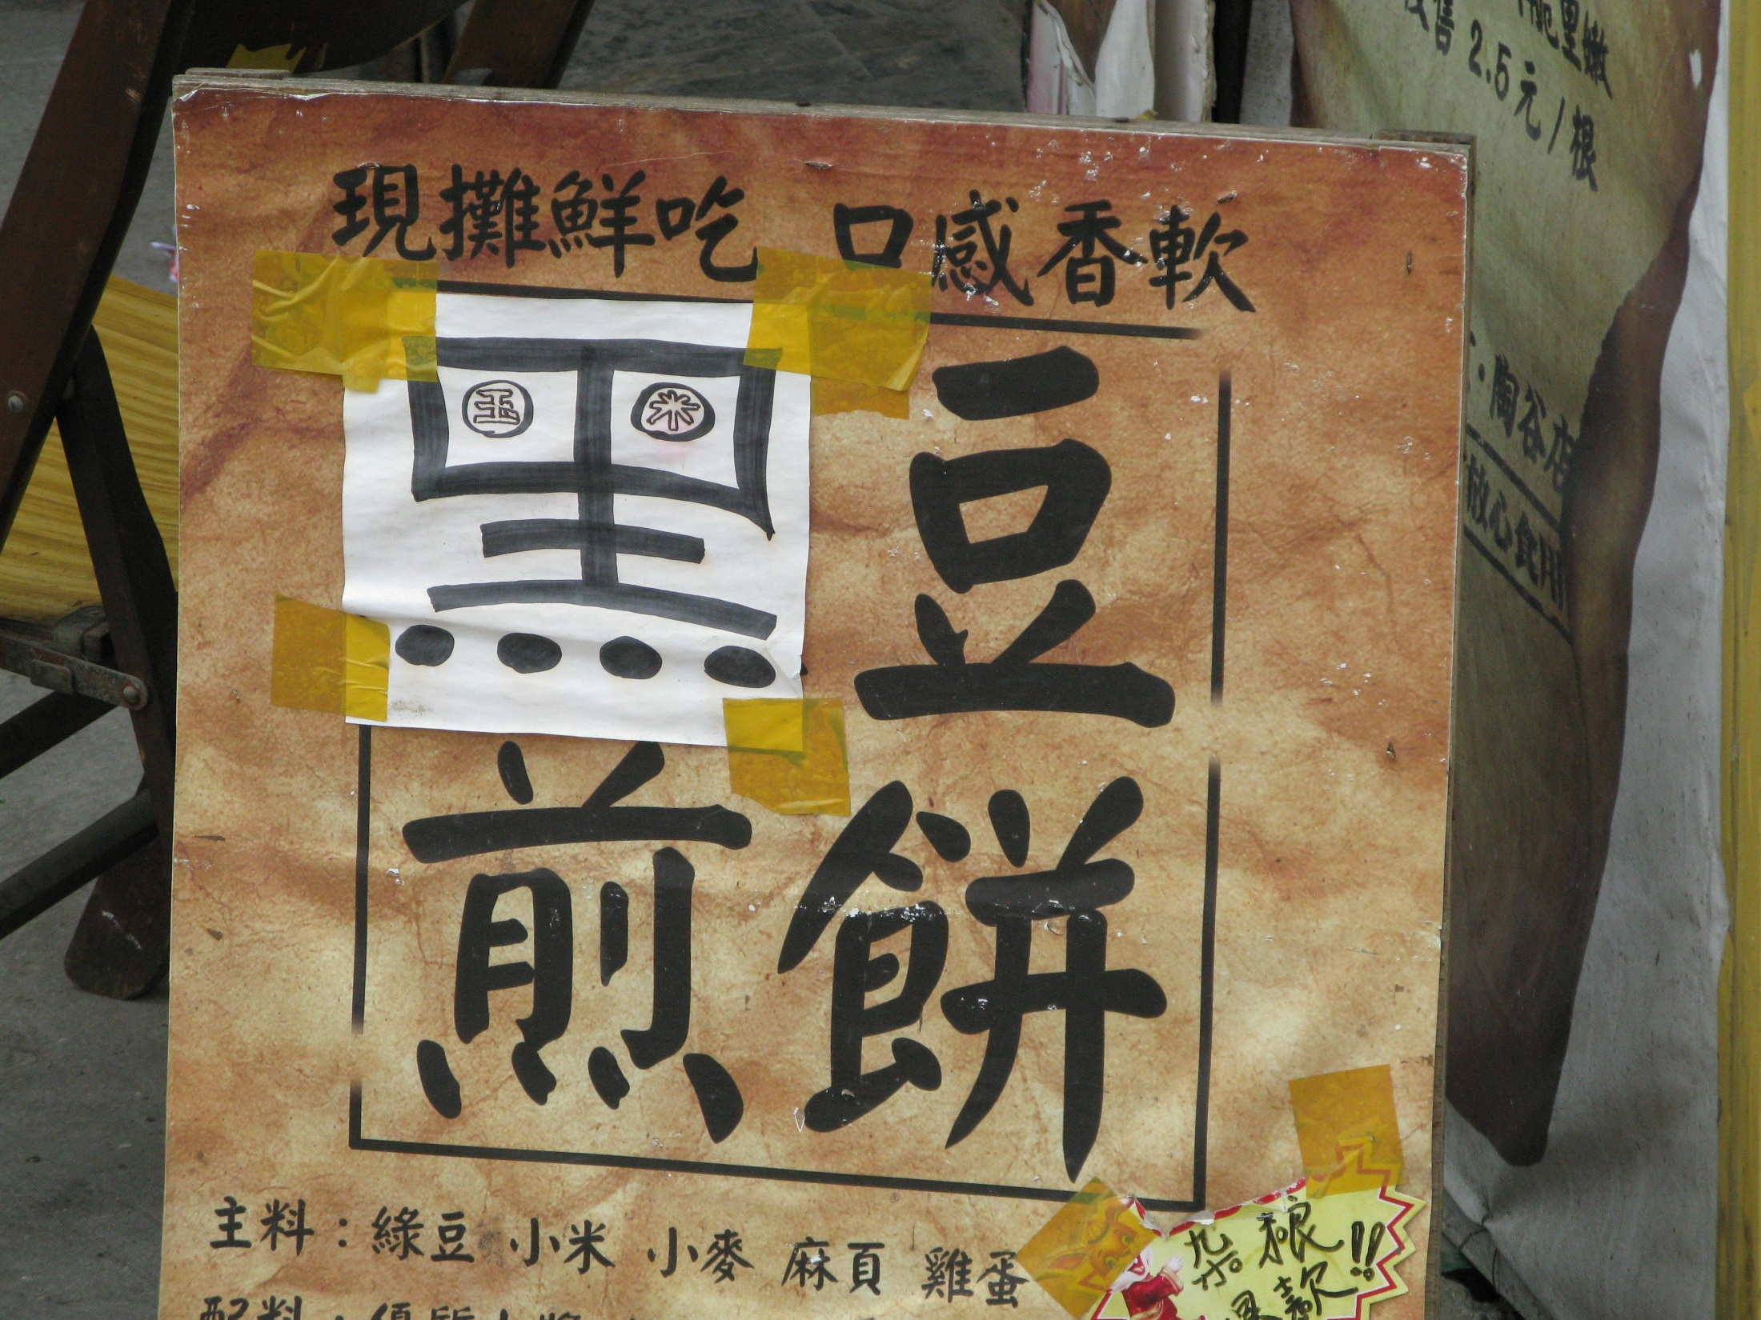

Slide 22
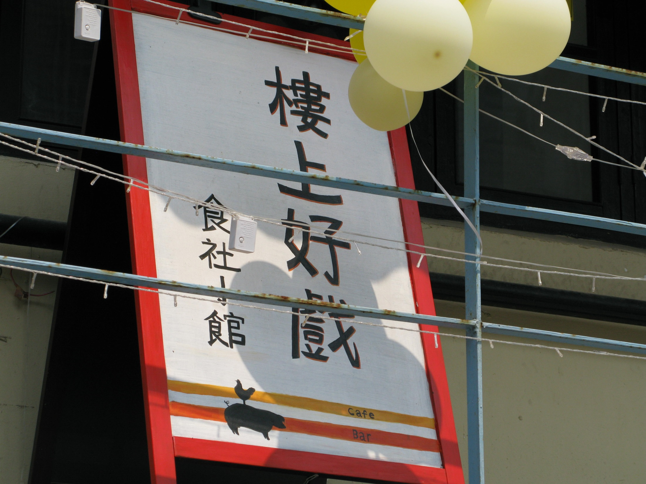

Slide 23
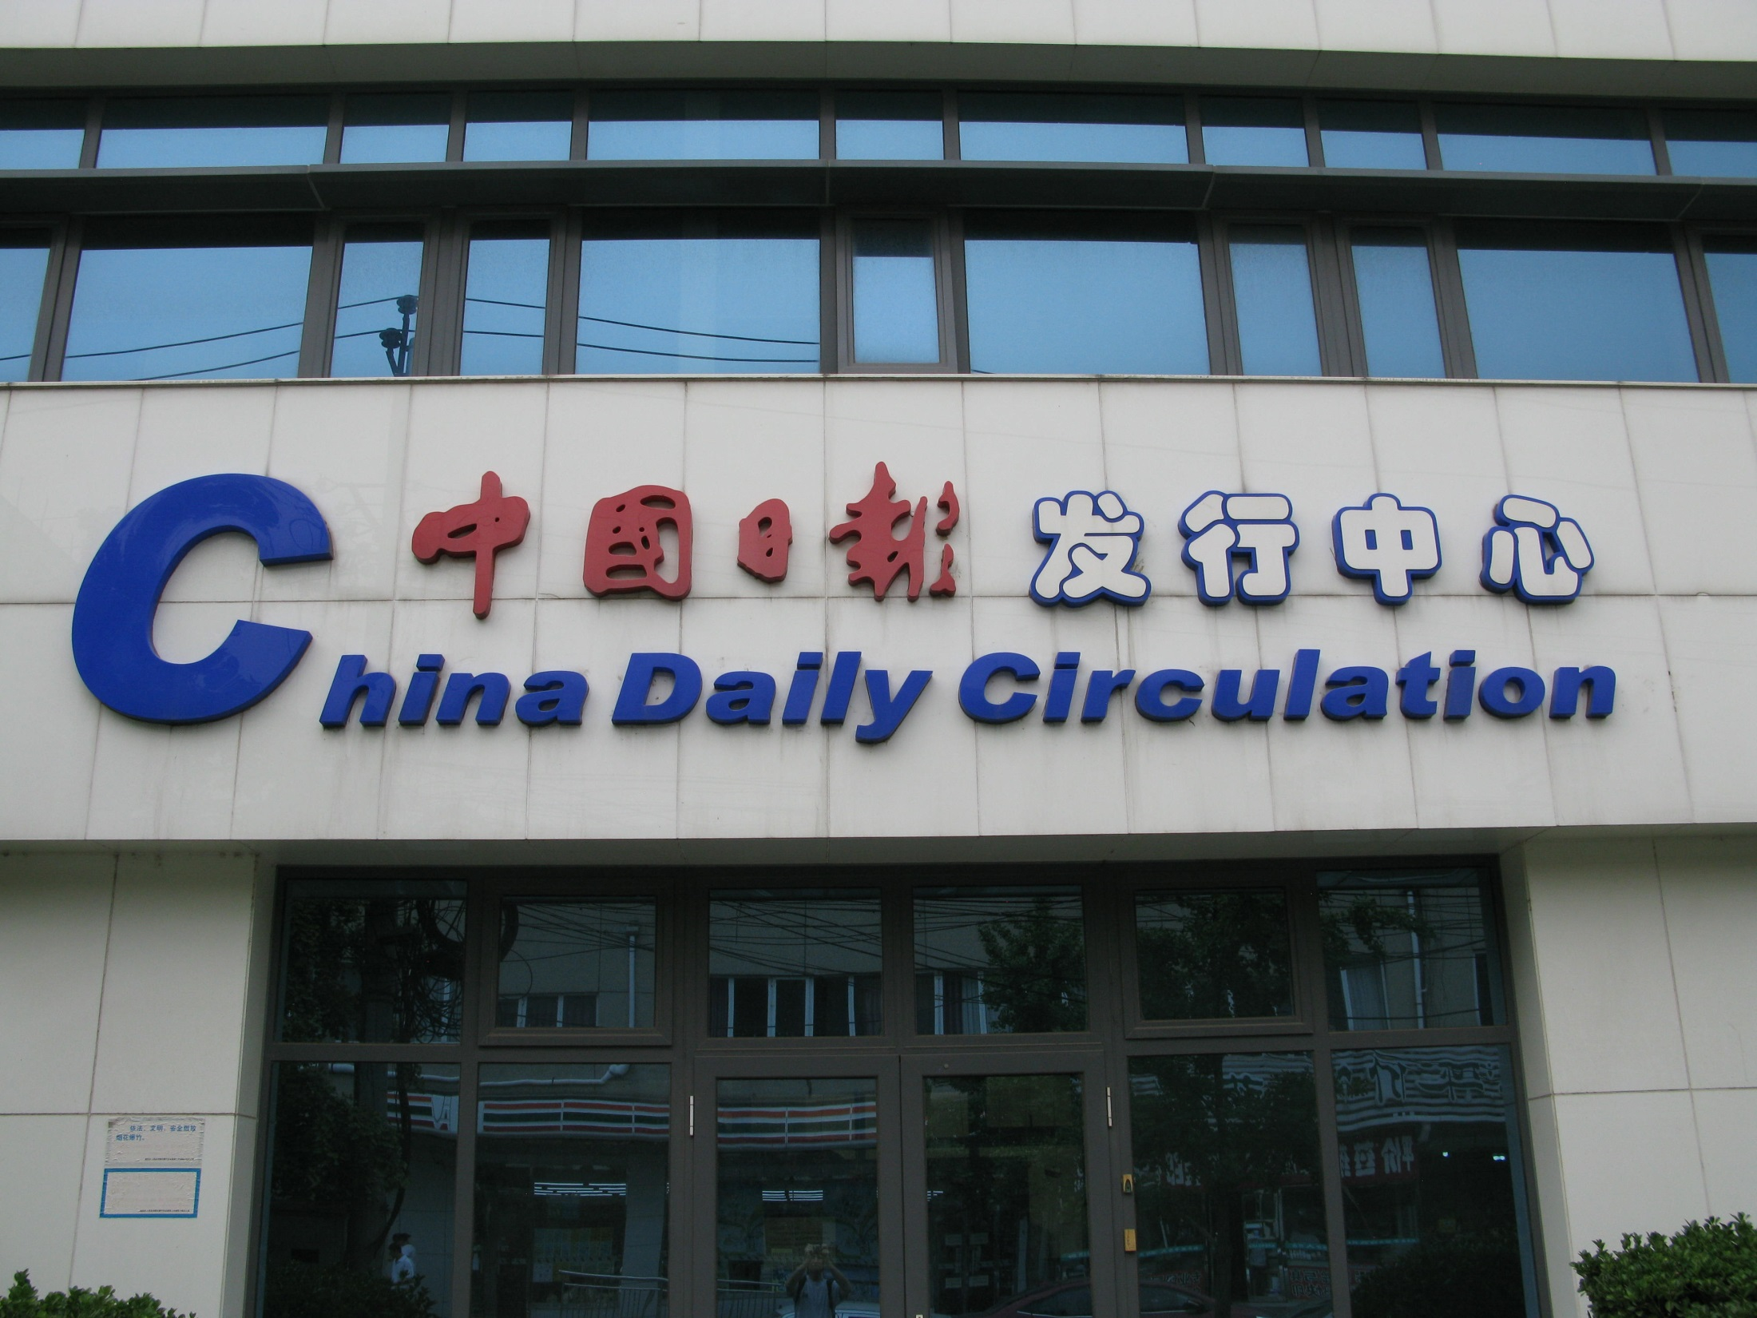

Slide 24
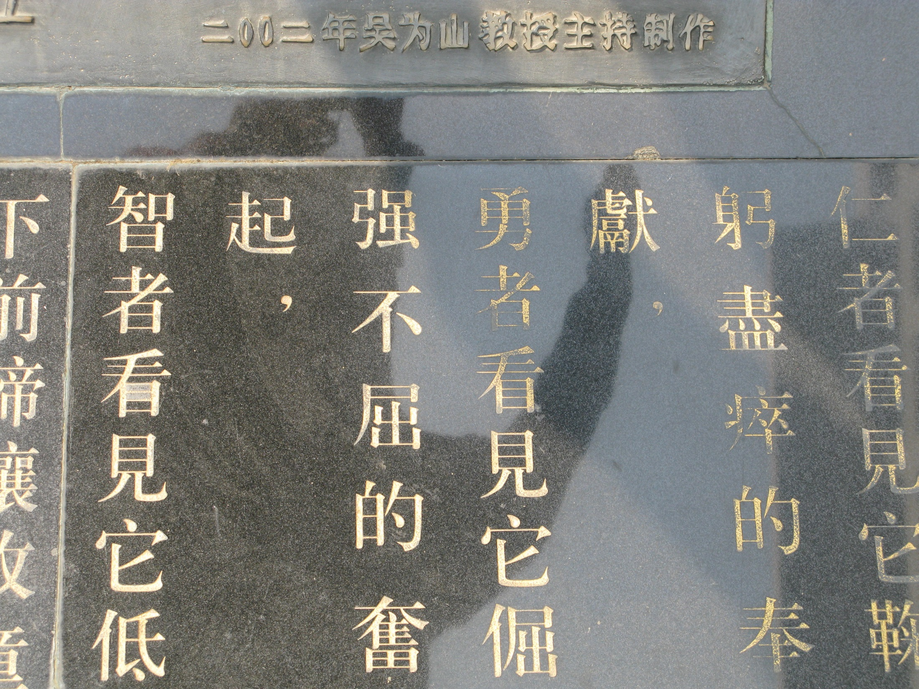

Slide 25
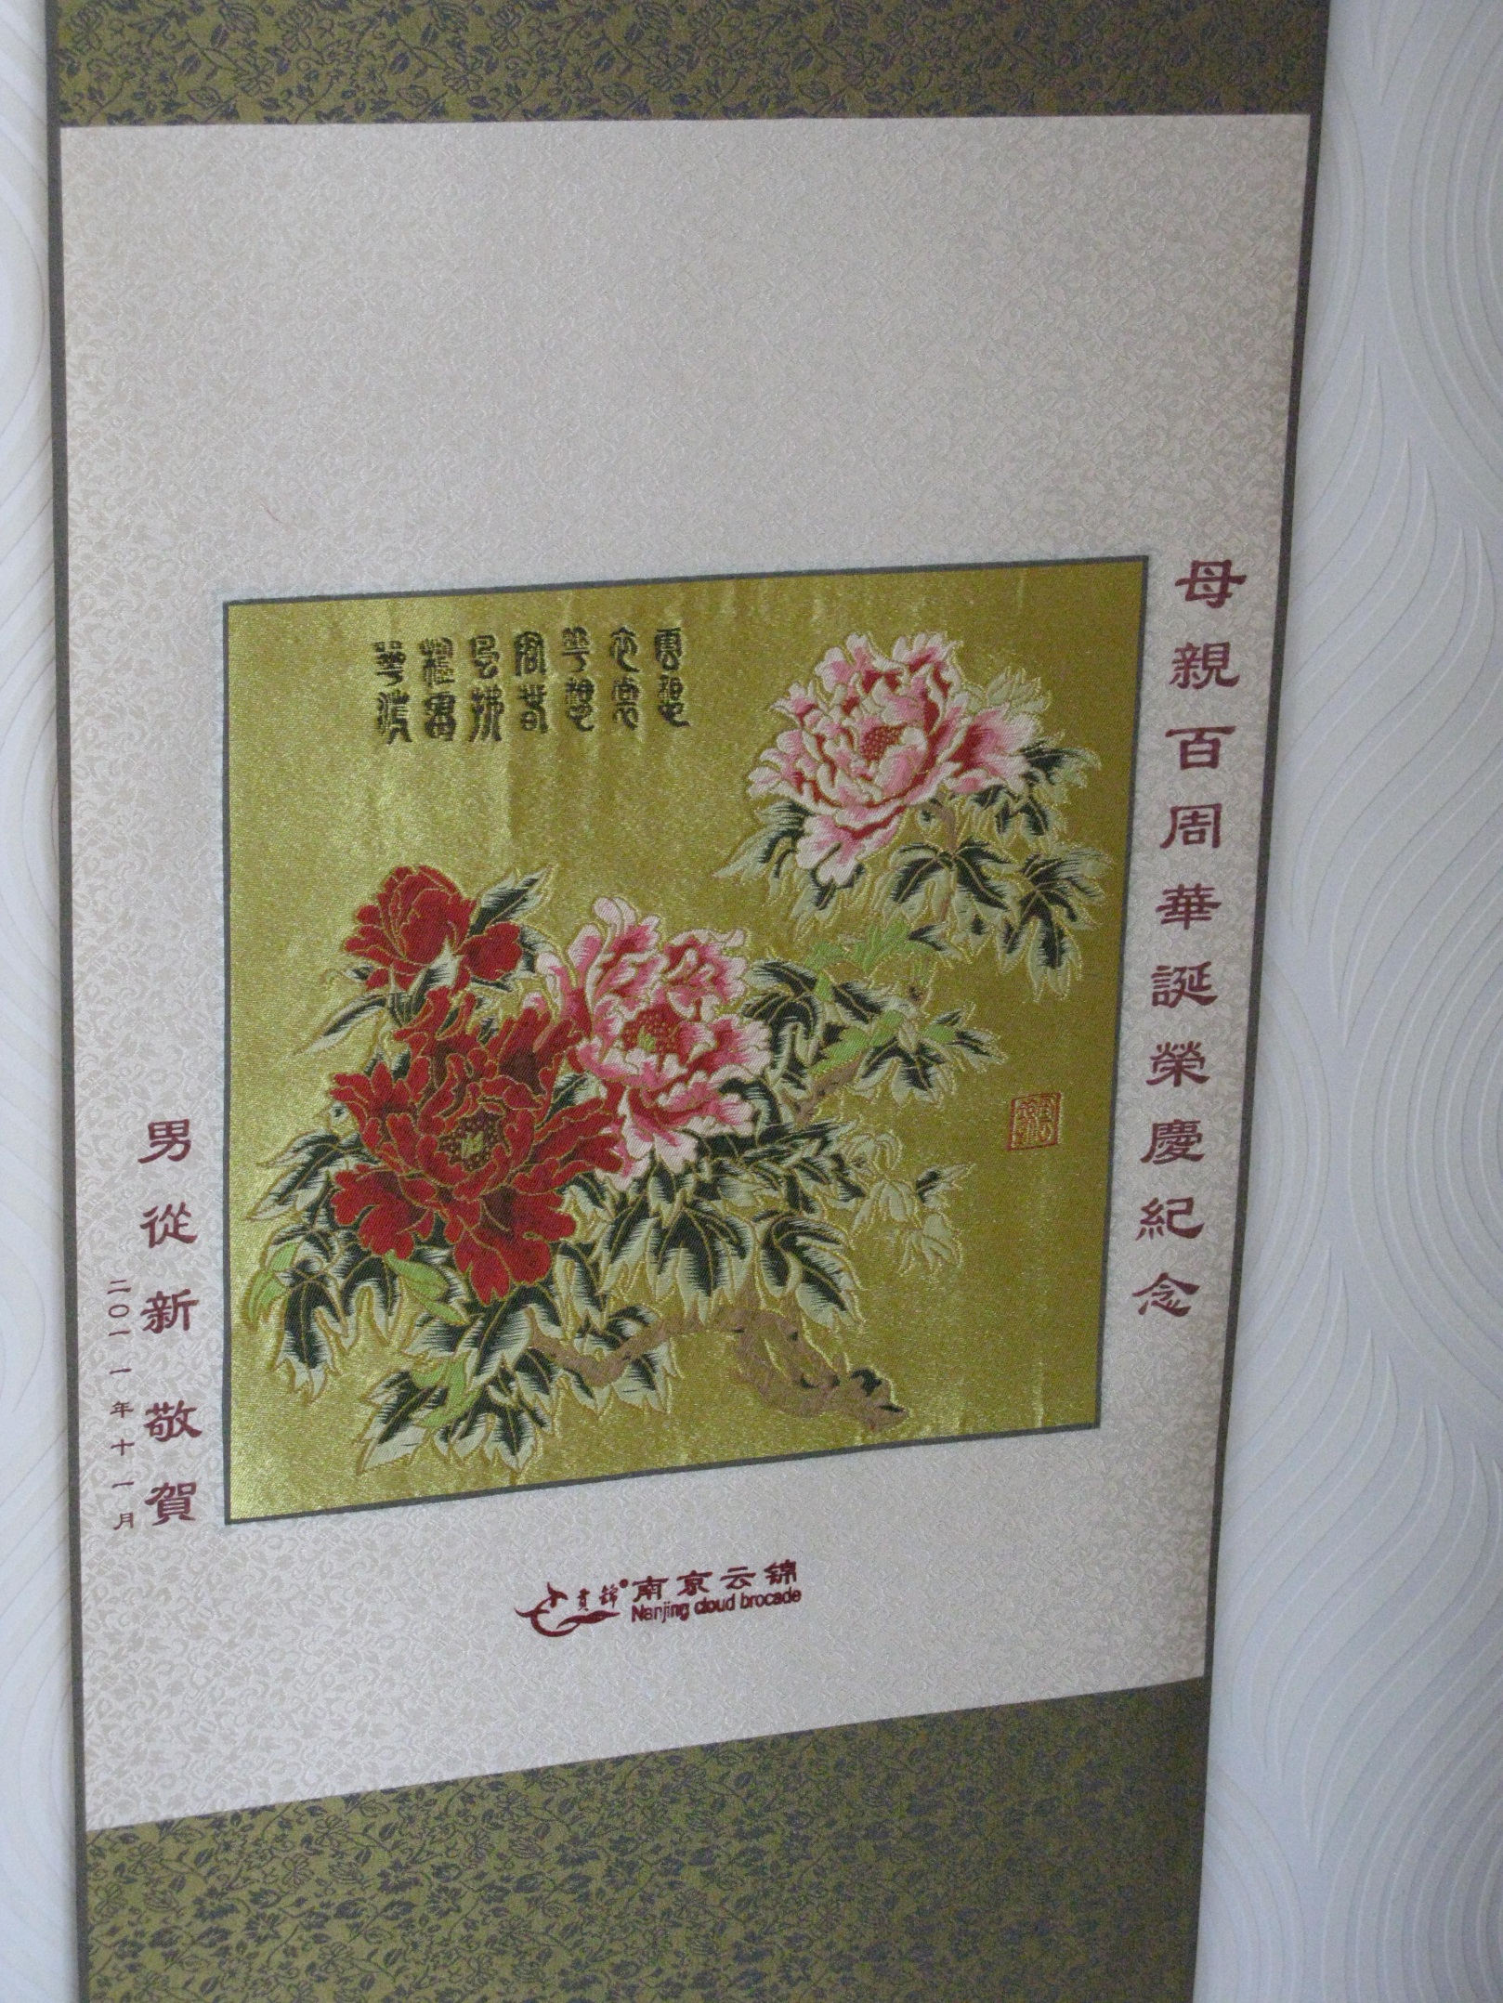

Slide 26
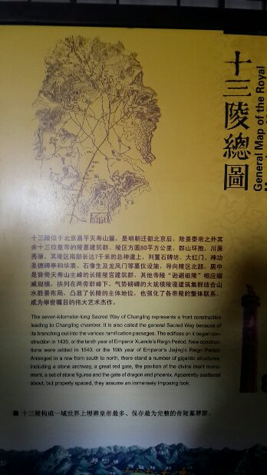

Slide 27


Slide 28
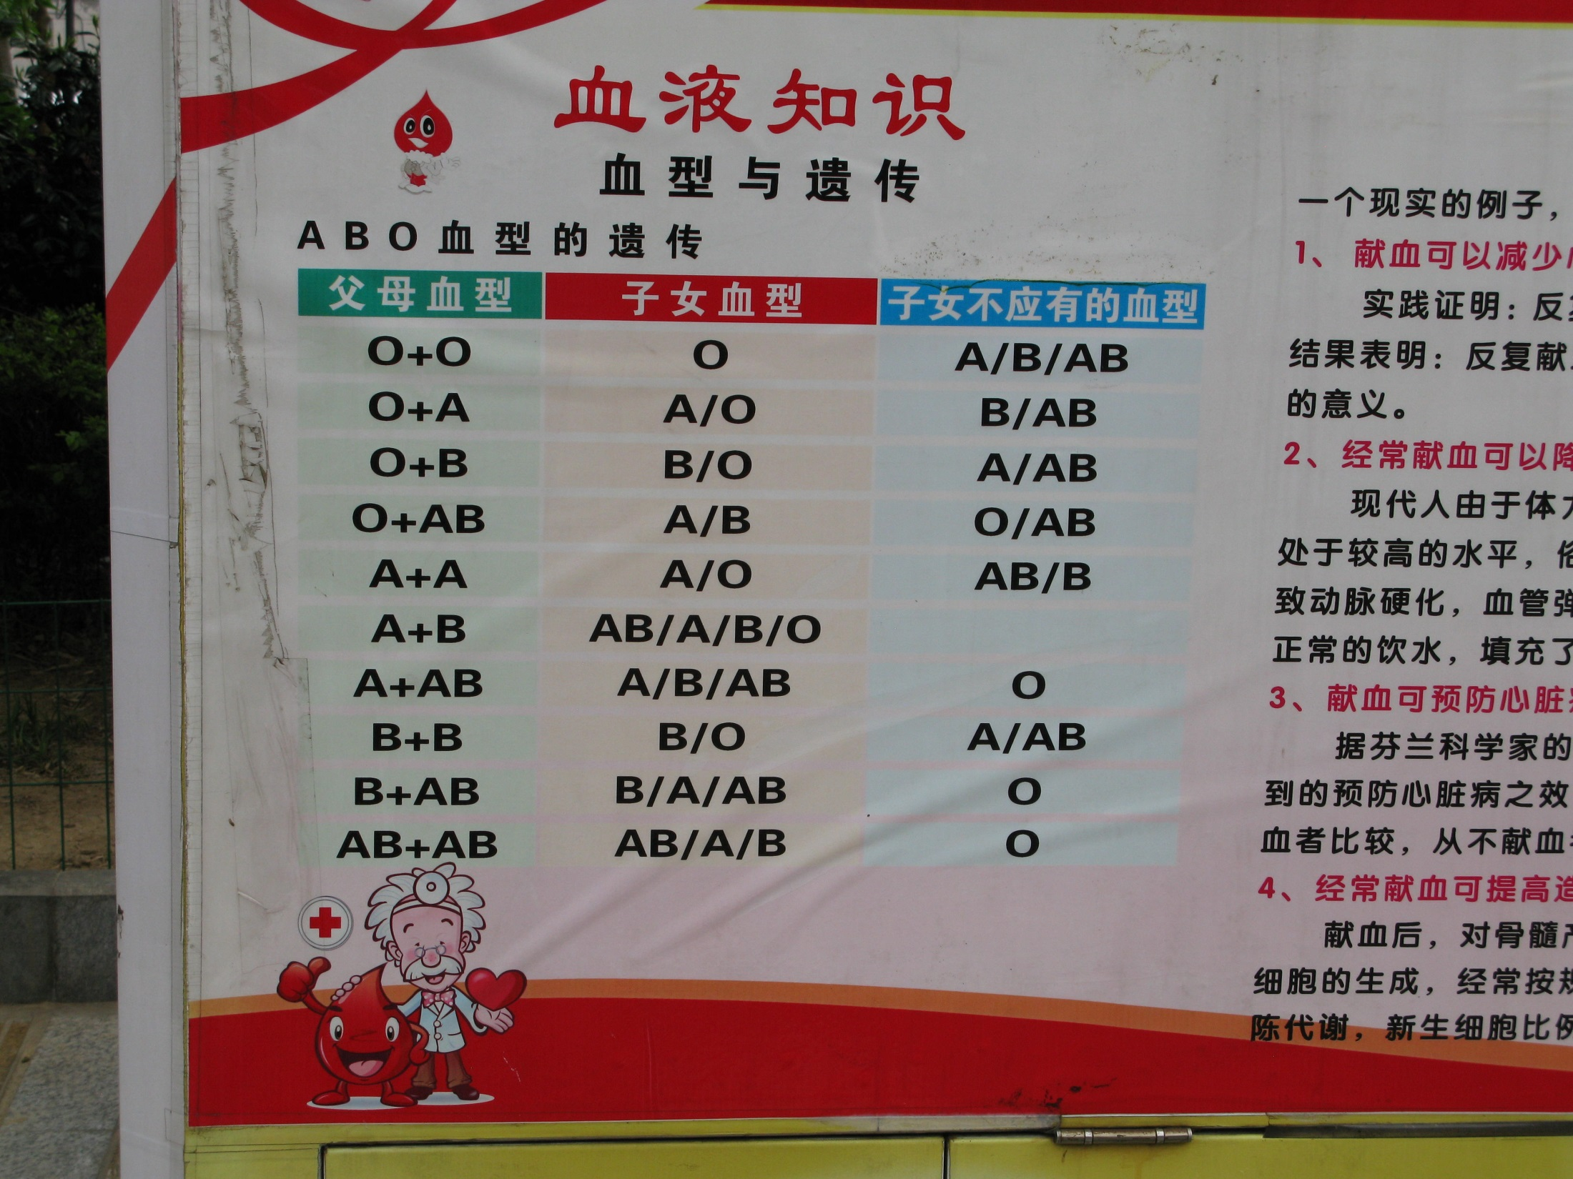

Slide 29


Slide 30


Slide 31
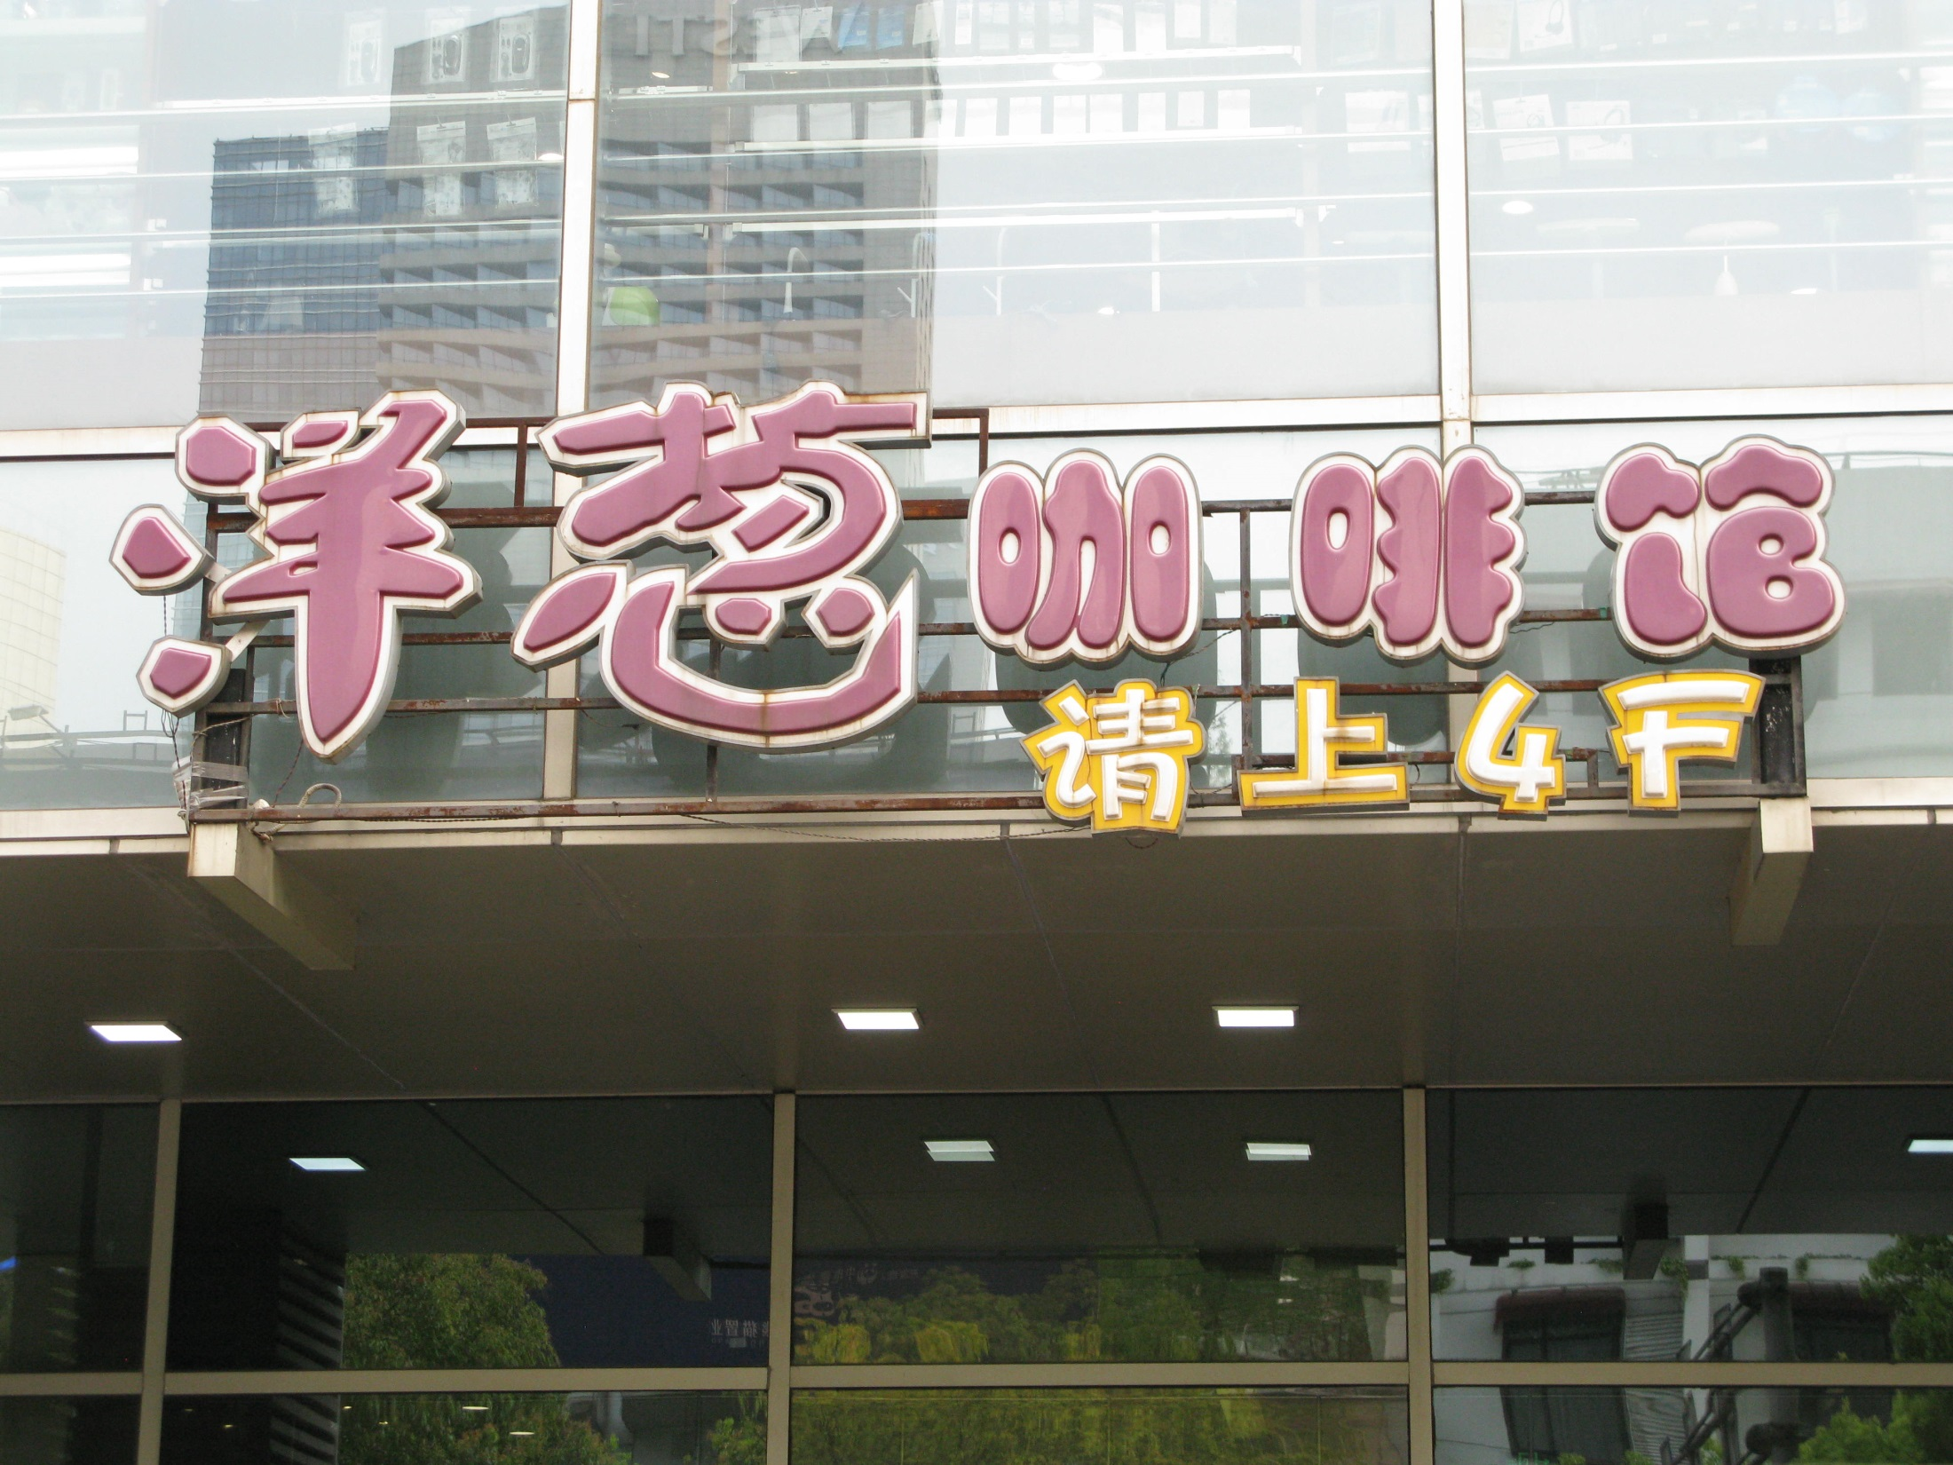

Slide 32


Slide 33
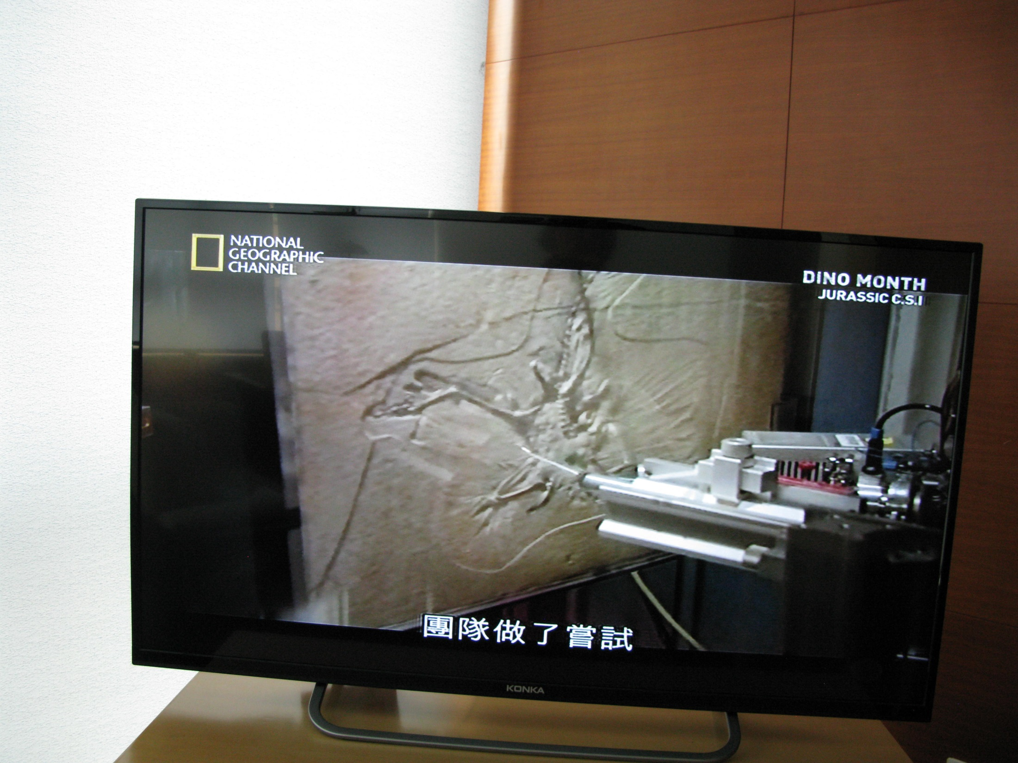

Slide 34
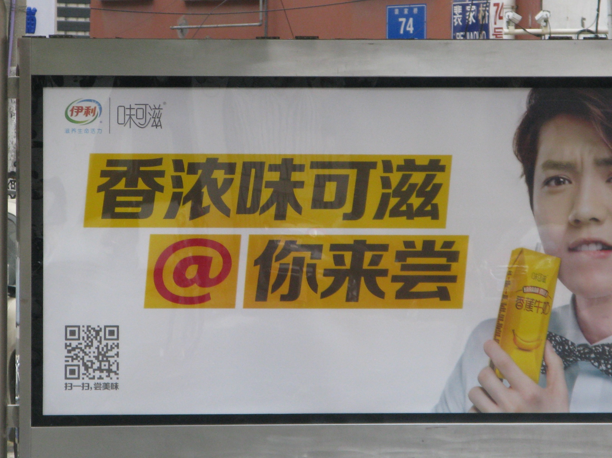

Slide 35
結論 Conclusions
1. 中文的書寫系統包含許多不同的成分，包括簡體和繁體字。
The Chinese writing system includes many different components, including both simplified and traditional characters.
2. 中文的母語者寫字時，根據需要從中文的書寫系統裡選出他們所需要的成分。
Native Chinese writers select the elements they need from the Chinese writing system based on their need, depending on the context and the message they wish to convey.

Slide 36
3. 中文的母語者能看懂甚麼，我們培訓出來的學生也應該能看懂甚麼。
Students should be able to read whatever native Chinese writers write.
4. 我們的學生結訓前，應該能看懂簡體字和繁體字。
Before completing training, students should be able to read both simplified and traditional characters.
5.對大多數外籍生而言，會手寫一種漢字就夠了。
For most students, it is sufficient if they are able to write one kind of characters by hand.

Slide 37
6. 理想中的中文閱讀課程應該包括下列成分：
An ideal Chinese reading curriculum should include the following components:
簡體字（但並非均為繁簡對照）
simplified characters (but not always parallel passages in simplified/traditional)
(b)繁體字（但並非均為繁簡對照）
traditional characters (but not always parallel passages in simplified/traditional)

Slide 38
(c)印刷體（包括各種字號和字體如宋體、明體、楷體……等）
print (including various type sizes and type fonts)
(d)手寫體（不同的人的手寫體，包括連筆字）
handwriting (by various individuals, including some moderately cursive writing)
(e) 中文書寫系統的其他成分（如異體字、羅馬字……等）
other components of the Chinese writing system (alternate characters, Roman alphabet, etc.)

Slide 39
7. 測驗要反映課程，因此閱讀測驗應該考學生對以上各種成分的閱讀能力。簡體字、繁體字應該分開考，不宜繁簡對照或讓學生自己選他們要考哪種字。
The testing system must reflect the curriculum, so reading tests should assess students' proficiency in reading the various components above. Arranging parallel passages in simplified and traditional characters and allowing students to choose which they wish to test in is usually not appropriate.

