Slide 1
應用數位工具達到
共同核心標準
ACS2015年會
講員: 長島文協
文健舜

Slide 2
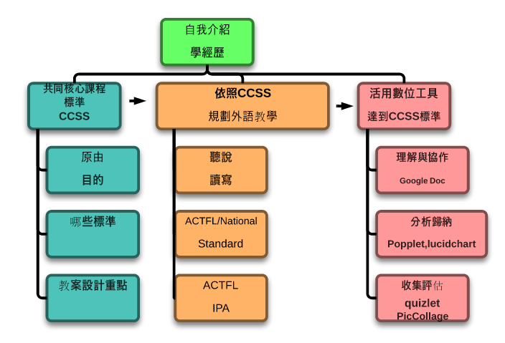

Slide 3
注意事項
不抄筆記...記下問題
不問問題…最後五分鐘
雲端簡報…會後寄發

Slide 4


核心目的是?
The Common Core State Standards (CCSSS) define the knowledge and skills students should have within their K-12 education experience to graduate high school and to be able to succeed in entry-level, credit-bearing academic college courses/workforce training programs.

Slide 5

什麼標準?
Build upon strengths/lessons of current state standards and are internationally benchmarked with top performing countries. 國際標準
Are clear, understandable and consistent. 理解,一致 數據化
Include rigorous content and application of knowledge through high-order skills.具挑戰,深層思考
Focus on learning expectations for students, not on specific methods of instruction, instructional resources. 學習目標 (技能,知識)
Notes:
Evidence based and research based

Slide 6

教案設計重點
Backward Design
Focus on results rather than means
Integrated model of literacy
  Processes of communication closely connected 聽說讀寫
Research and media skills blended into Standards 網路搜尋及多媒體能力
Shared responsibility for students’ literacy development
  Special emphasis on
  informational text 資訊類文
Notes:
Combine the communication skills with media skills will be further discuss in details.

Slide 7

Sit Tight & Buckle up
It’s STANDARDS time!

Slide 8

ELA Anchor Standards for Speaking and Listening
Comprehension and Collaboration:
理解與協作
CCSS.ELA-LITERACY.CCRA.SL.1
Prepare for and participate effectively in a range
of conversations and collaborations with diverse partners, building on others' ideas and expressing their own clearly and persuasively.
CCSS.ELA-LITERACY.CCRA.SL.2
Integrate and evaluate information presented in diverse media and formats, including visually, quantitatively, and orally.
CCSS.ELA-LITERACY.CCRA.SL.3
Evaluate a speaker's point of view, reasoning, and use of evidence and rhetoric.
Notes:
Language function: 说服，表达，整合并评定资讯，申论，论述
Language form
初级：我喜欢…
中级：因为…; 比较；所以；
高级： 根据， 依照；仍然

Slide 9
ELA Anchor Standards for Speaking and Listening
Presentation of Knowledge and Ideas: 發表意見
CCSS.ELA-LITERACY.CCRA.SL.4
Present information, findings, and supporting evidence such that listeners can follow the line of reasoning and the organization, development, and style are appropriate to task, purpose, and audience.
CCSS.ELA-LITERACY.CCRA.SL.5
Make strategic use of digital media and visual displays of data to express information and enhance understanding of presentations.
CCSS.ELA-LITERACY.CCRA.SL.6
Adapt speech to a variety of contexts and communicative tasks, demonstrating command of formal English when indicated or appropriate.

Slide 10
Anchor Standards for Reading
Key Ideas and Details:
CCSS.ELA-LITERACY.CCRA.R.1
Read closely to determine what the text says explicitly and to make logical inferences from it; cite specific textual evidence when writing or speaking to support conclusions drawn from the text.
CCSS.ELA-LITERACY.CCRA.R.2
Determine central ideas or themes of a text and analyze their development; summarize the key supporting details and ideas.
CCSS.ELA-LITERACY.CCRA.R.3
Analyze how and why individuals, events, or ideas develop and interact over the course of a text.
Notes:
Mind mapping

Slide 11
Anchor Standards for Reading
Craft and Structure: 文體與結構
CCSS.ELA-LITERACY.CCRA.R.4
Interpret words and phrases as they are used in a text, including determining technical, connotative, and figurative meanings, and analyze how specific word choices shape meaning or tone.
CCSS.ELA-LITERACY.CCRA.R.5
Analyze the structure of texts, including how specific sentences, paragraphs, and larger portions of the text (e.g., a section, chapter, scene, or stanza) relate to each other and the whole.
CCSS.ELA-LITERACY.CCRA.R.6
Assess how point of view or purpose shapes the content and style of a text.
Notes:
轉折語, 介詞

Slide 12
Anchor Standards for Reading
Research to Build and Present Knowledge: 研究報告
CCSS.ELA-LITERACY.CCRA.W.7
Conduct short as well as more sustained research projects based on focused questions, demonstrating understanding of the subject under investigation.
CCSS.ELA-LITERACY.CCRA.W.8
Gather relevant information from multiple print and digital sources, assess the credibility and accuracy of each source, and integrate the information while avoiding plagiarism.
CCSS.ELA-LITERACY.CCRA.W.9
Draw evidence from literary or informational texts to support analysis, reflection, and research.

Slide 13
Anchor Standards for Reading
Integration of Knowledge and Ideas: 整合資料
CCSS.ELA-LITERACY.CCRA.R.7
Integrate and evaluate content presented in diverse media and formats, including visually and quantitatively, as well as in words.
(圖表, 漫畫)
CCSS.ELA-LITERACY.CCRA.R.8
Delineate and evaluate the argument and specific claims in a text, including the validity of the reasoning as well as the relevance and sufficiency of the evidence.
CCSS.ELA-LITERACY.CCRA.R.9
Analyze how two or more texts address similar themes or topics in order to build knowledge or to compare the approaches the authors take.
Notes:
Example

Slide 14
Anchor Standards for Writing
Text Types and Purposes
CCSS.ELA-LITERACY.CCRA.W.1
Write arguments to support claims in an analysis of substantive topics or texts using valid reasoning and relevant and sufficient evidence.
CCSS.ELA-LITERACY.CCRA.W.2
Write informative/explanatory texts to examine and convey complex ideas and information clearly and accurately through the effective selection, organization, and analysis of content.
CCSS.ELA-LITERACY.CCRA.W.3
Write narratives to develop real or imagined experiences or events using effective technique, well-chosen details and well-structured event sequences.

Slide 15
Anchor Standards for Writing
Production and Distribution of Writing:
CCSS.ELA-LITERACY.CCRA.W.4
Produce clear and coherent writing in which the development, organization, and style are appropriate to task, purpose, and audience.
CCSS.ELA-LITERACY.CCRA.W.5
Develop and strengthen writing as needed by planning, revising, editing, rewriting, or trying a new approach.
CCSS.ELA-LITERACY.CCRA.W.6
Use technology, including the Internet, to produce and publish writing and to interact and collaborate with others.

Slide 16
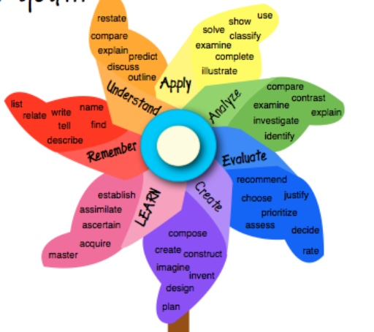
Bloom’s Taxonomy
High-order
Low-order

Slide 17
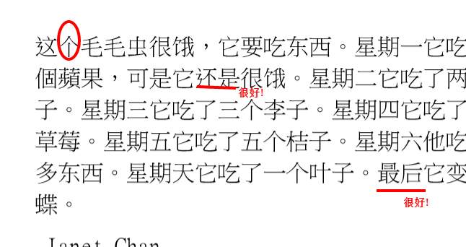
讀寫
先看影片/ebook (miss panda chinese on youtube)
Summary
課堂腦力激盪 (課後自選題目, 媒體創作方式 )

Slide 18
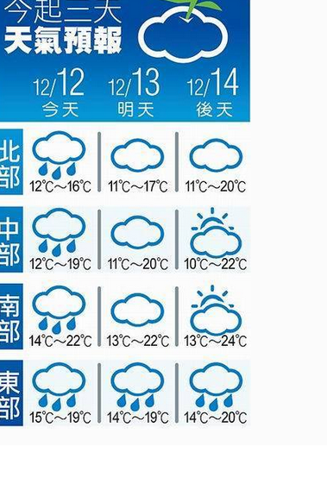
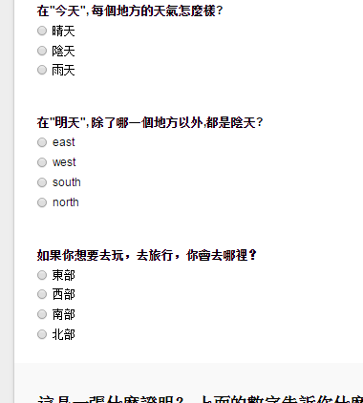
Sample made with Google Form

Slide 19
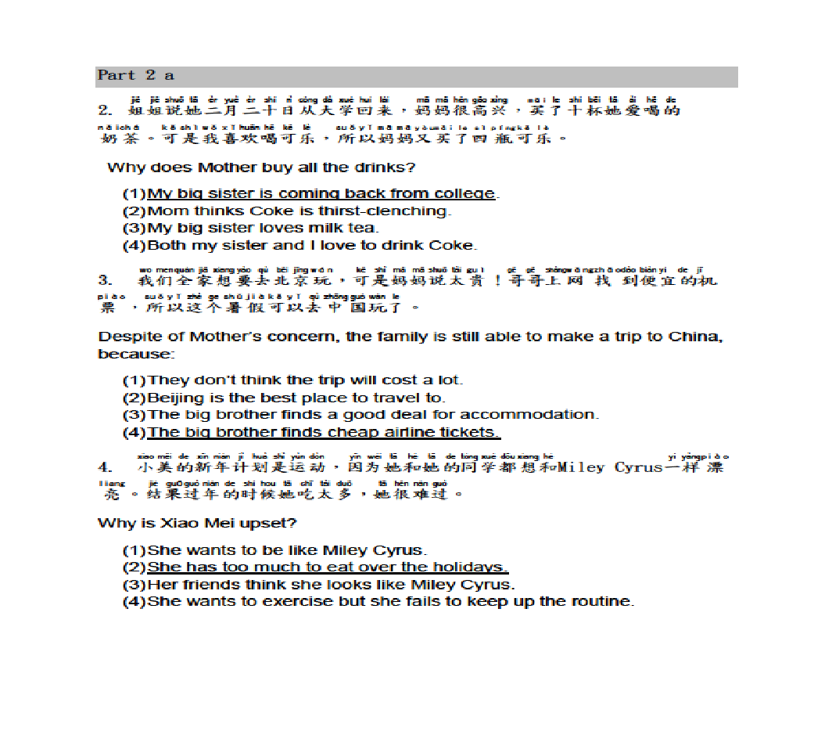

Slide 20
如何應用共同核心標準
規劃外語教學
COMMUNICATION
COMPARISONS
CONNECTIONS
COMMUNITIES
CULTURES
ACTFL教學標準
5C’s

Slide 21
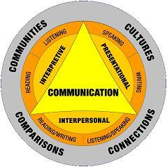
Integrated Performance Assessment (IPA)
3 MODES

Slide 22

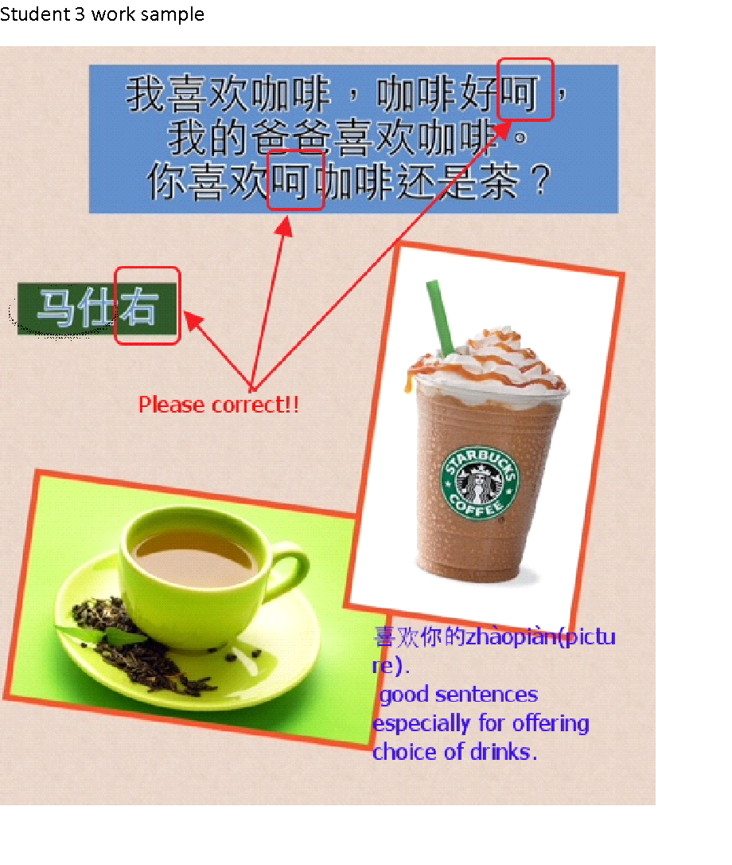
實務範例
Interpretive mode task/with questions
Inpterpersonal mode task
worksheet
Presentational mode task

Slide 23
如何活用數位工具/介面
達到 CC 標準
App
Web
cloud

Slide 24
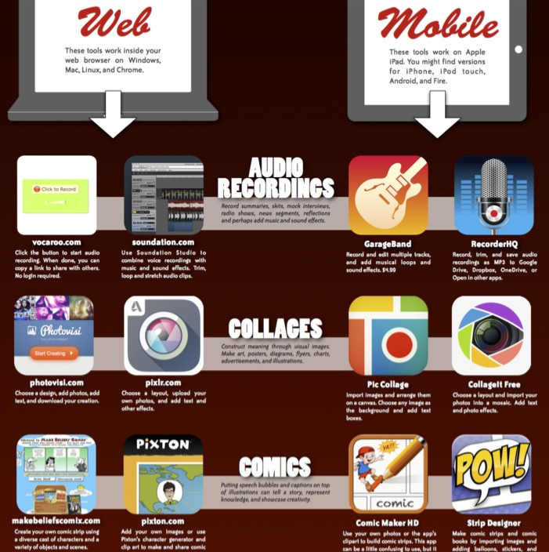



Slide 25
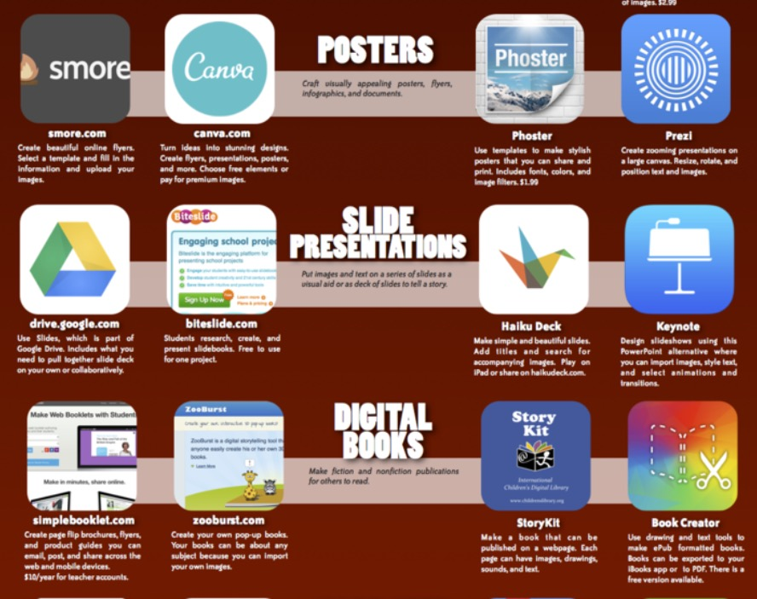

Slide 26
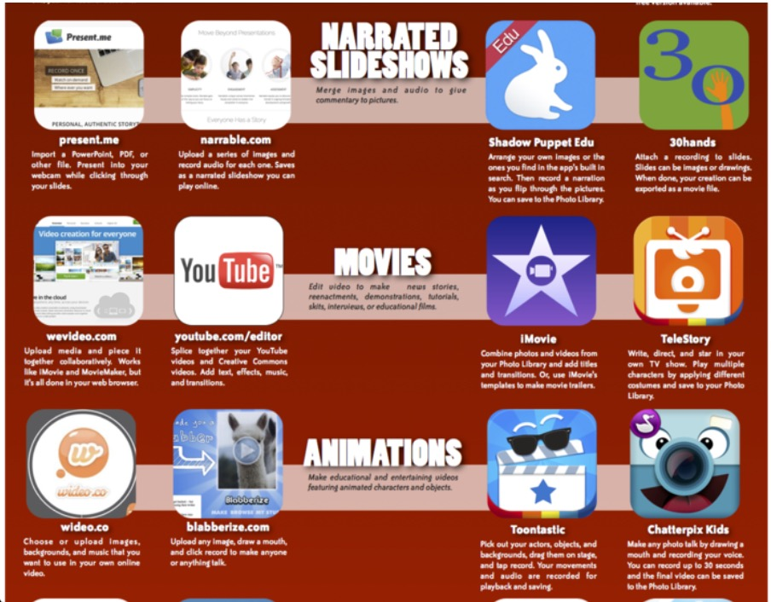




Slide 27
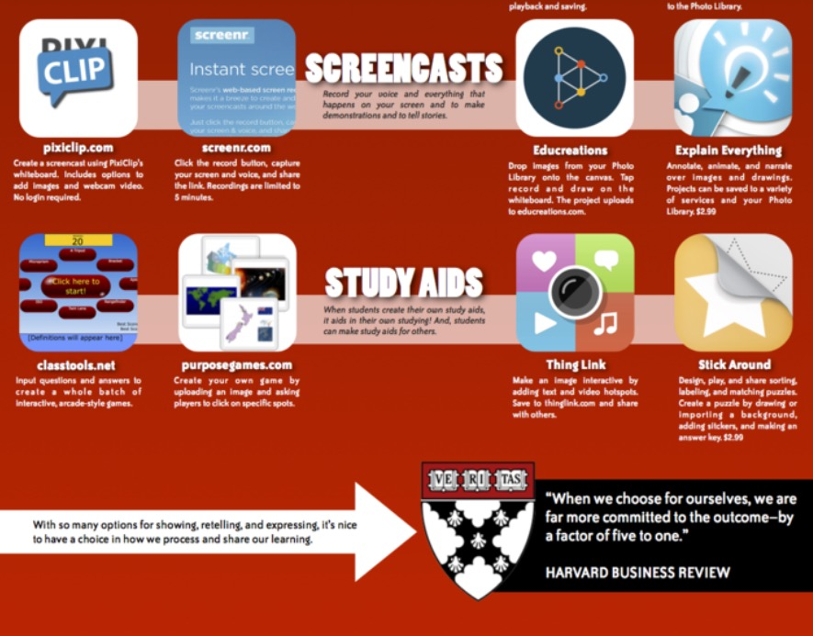

Slide 28
Google Drive 用途多
Google Doc

