Slide 1
因材施教
如何設計出有趣、有效
又適合不同學生背景的教材
汪詠萃
北維州實驗中文學校
yuang@fcps.edu

Slide 2
了解學生:
  背景(語言)
  程度
  學生喜歡什麼
  學生有什麼特長

Slide 3
學生喜歡做什麼?
喜歡說話
喜歡跟朋友在一起
喜歡玩遊戲
好動
Notes:
3

Slide 4
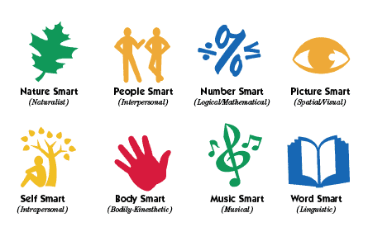
多元智能理論 Multiple Intelligences
Nature Smart
自然
People Smart
人際交往
Number Smart
邏輯/數學
Picture Smart
空間/視覺
Self Smart
內省
Body Smart
身體/動感
Music Smart
音樂
Word Smart
語言

Slide 5
Backward design
訂定教學目標:
  目標必須是功能性
  目標必須是能評量的

Slide 6
Backward design
設計教學活動:
  有效
  有趣

Slide 7
“以老師為中心的教學”
“以學生為中心的學習”

Slide 8
Balance between teacher center and students center
Large group
Small groups
Work in pairs
Individual work

Slide 9
Large group - introduce new information
Teacher center
Five to ten minutes
Interactive PPT slideshow
Interactive SMART notebook lesson
Q and A
TPR Song

Slide 10
Small groups
Students center
SMART board fun games
Board game
Group project
Role Play
Fun Activities

Slide 11
Work in Pairs
Student Center
Kagan Structure:
Shoulder Partners / Face Partners
字卡遊戲
比手畫腳

Slide 12
Individual work
Student center - teacher serve as facilitator
Hands on-
  Worksheet
  Booklet
  Project

Slide 13
示範單元 一動物住在哪裡?
Large group: PPT 介紹地形和動物
Group practice: SMART board game 練習動物名稱
Small group practice - dice game
Individual work - Animal project
Pair work – Rally Robin 相互提問

Slide 14
示範單元 一點中國菜
Large group: PPT 介紹各種不同的食物
Small group practice – Simultaneous Round Table
Pair work – Rally Robin 相互提問
Presentation - 角色扮演: 點中國菜

Slide 15
How to make an Animated PPT

Slide 16
因材施教
Teach kids, not lessons

Slide 17

再見

Slide 18
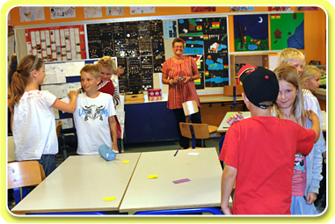
Kagan
Hands-on Cooperative Learning
Notes:
Stand up if you…

Slide 19
Basic Kagan Structures:
RallyRobin (2) & RoundRobin (4):
  Students take turns responding orally. In RallyRobin, partners take turns. In RoundRobin, students take turns in their team (table).
RallyTable & RoundTable:
Students take turns generating written responses. In RoundTable, studens take turns in their teams. In RallyRobin, partners take turns.
StandUp-HandUp-PairUp:
  Students stand up, put their hands up, and quickly find a partner with whom to share or discuss.
Inside-Outside Circle:
  Students rotate in concentric circles to face new partners for sharing, quizzing, or problem solving.
Notes:
Stand up if you…

Slide 20


Kagan Structure
Quiz Quiz Trade
Stand Up, Hand Up, Pair Up
Partner A Quizzes B.
Partner B Answers.
Partner A Coaches and Praises.
Switch Roles and Repeat.
Partners Trade Cards and thank each other.
Hand Up and Find a New Partner.
Repeat Procedure Until Time is Called.
Notes:
Stand up if you…

Slide 21
Kagan Structure
Match Mine
Students work in pairs. The Sender arranges game pieces on game board while receiver waits quietly.
Sender gives the Receiver directions to match the Sender’s arrangement of game pieces on the game board.
When finished, partners set game board side by side to check for accuracy.
Receiver praises Sender, and they develop improvement strategies.
Switch Roles and Repeat.

Slide 22
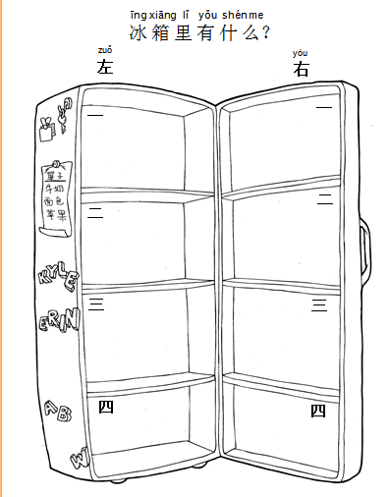







Slide 23
Interactive PPT
    Introduce new theme or topics
      Tree in four seasons
      Animal Habitats
    TPR Story Telling
      Very Hungry Caterpillar
      Seven Blind Mice

Slide 24
Interactive PPT
TPR Songs
      兩隻老虎
      七大洲之歌
      肚子餓了
Interactive fun games
  猜字遊戲
  Chinese Holiday Jeopardy
  Food Pyramid Games

Slide 25
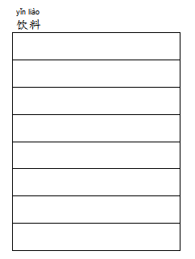

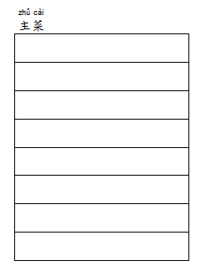
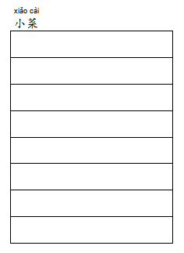


Slide 26
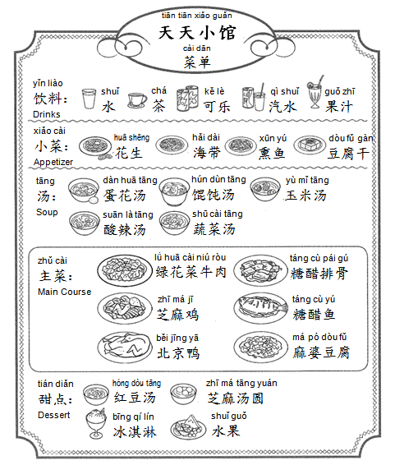
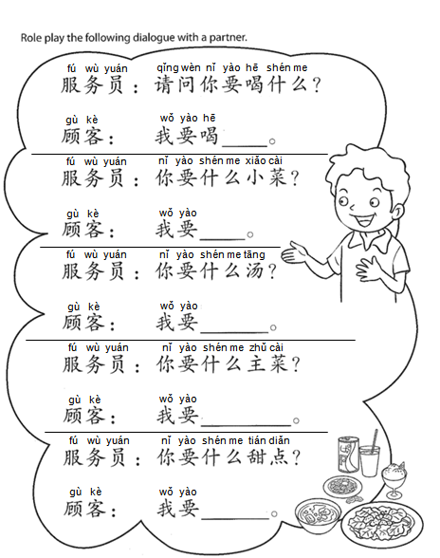

Slide 27
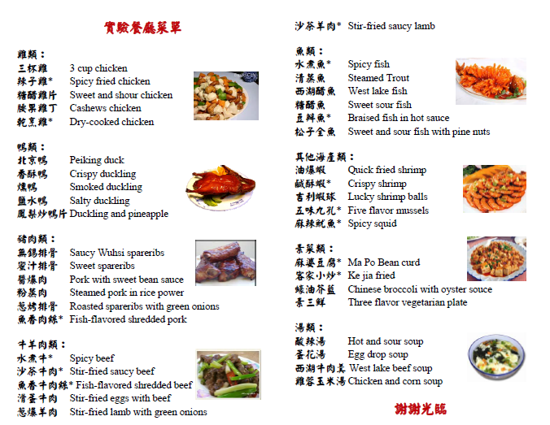

Slide 28
短劇：在餐廳
狀況：兩三位好友去餐廳吃飯，各人口味不同習慣不同，發生的事情
狀況1：服務員介紹餐廳的拿手菜，每個人只管自己的口味，搶著點菜，不管別人是否喜歡。用餐時只管自己大吃大喝，大聲講話，不管別桌的客人。吃完飯，搶著買單。
角色：服務員、客人三位(一位喜歡吃辣，一位不敢吃辣愛吃甜的，一位喜歡吃鹹的)
狀況 2：服務員介紹餐廳的拿手菜，並幫忙客人決定菜色。每個人都詢問別人的喜好，不能決定點什麼菜。用餐食禮讓，輕聲談話。吃完飯，各付各的費用。
角色：服務員、客人三位(一位喜歡吃辣，一位不敢吃辣愛吃甜的，一位喜歡吃鹹的
任務：討論可能發生情況的細節(點菜時可能發生的事，吃飯時可能發生的事，買單時可能發生的事)
對白：每一個人都要有講話的機會

Slide 29







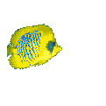



大海
哪些動物住在大海？
這些動物住在大海。

Slide 30
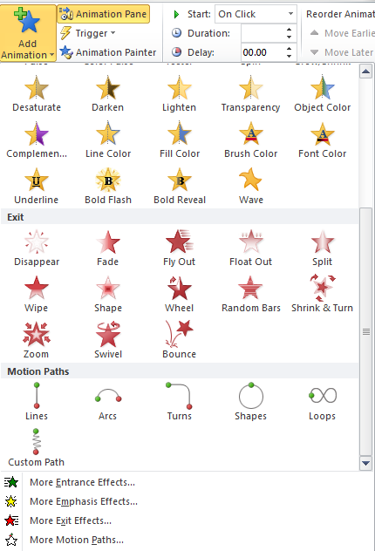
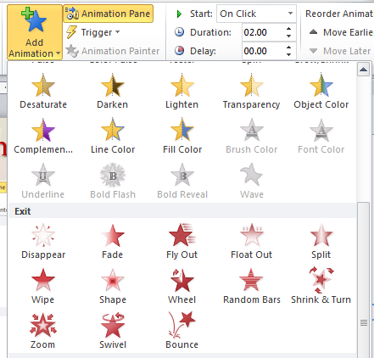
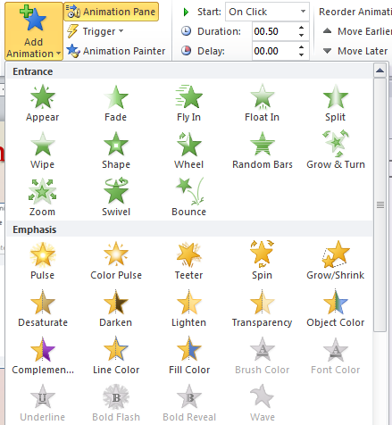
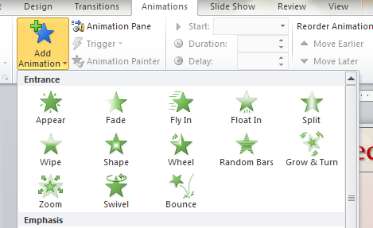
How to make an Animated PPT
Add Effect
  Entrance
  Emphasis
  Exit
  Motion Paths

Slide 31
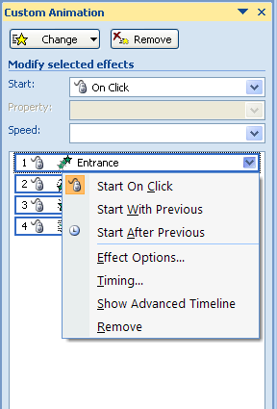
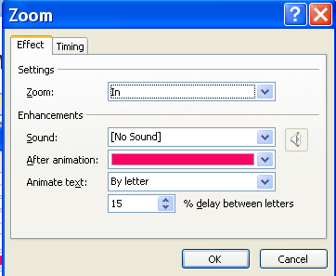
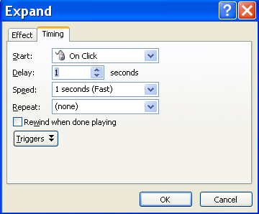
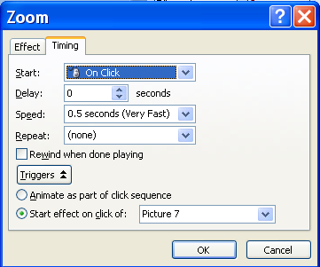

How to make an Animated PPT
Effect Options
  Effect
  Timing
  Triggers
Click Me

Slide 32
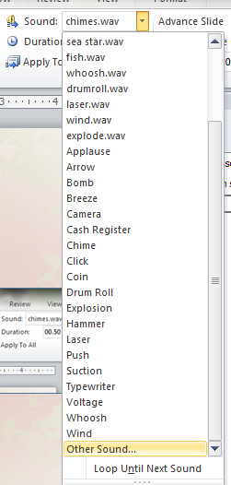
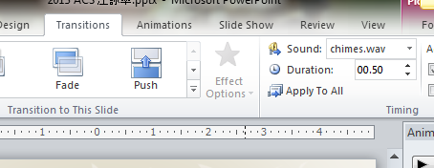
如何讓 PPT 說話/發聲
  Play the sound with slide show
    Transition sound:

Slide 33
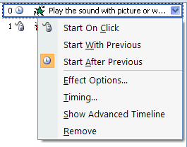
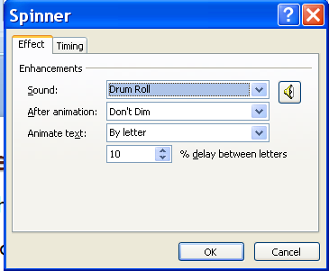
如何讓 PPT 說話/發聲
  Play the sound with picture or word
    Effect Option
      Sound

Slide 34
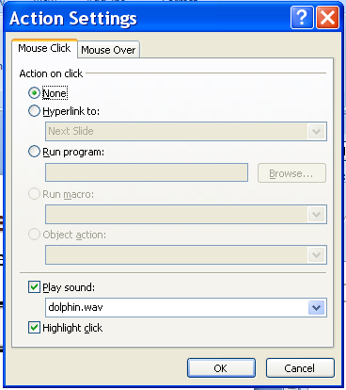
如何讓 PPT 說話/發聲
  Play the sound when click on the picture or word
    Insert Action
      Action Settings

